Slide 1
Sequence-to-sequence models

Slide 2
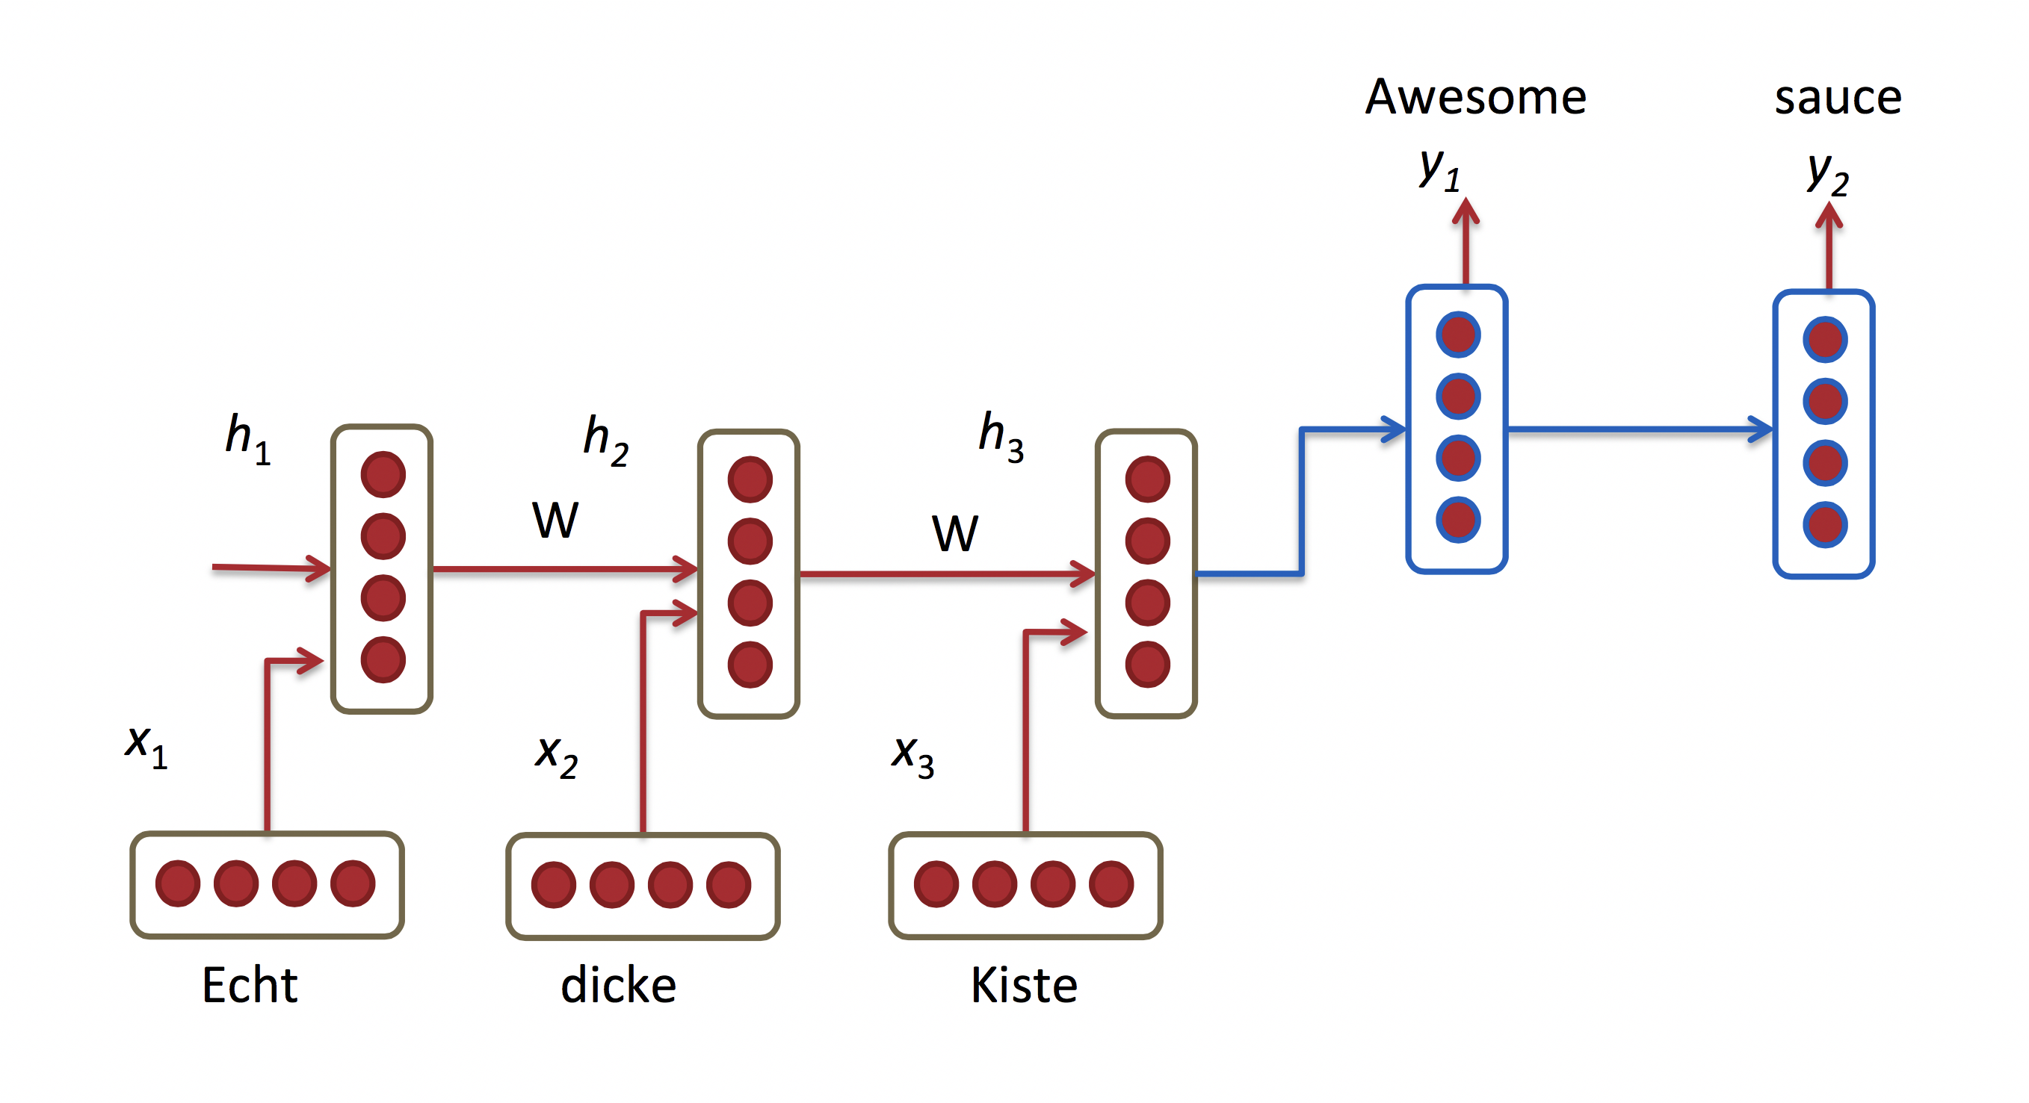
Seq2seq (Sutskever et al., 2014)
Decoder RNN
Encoder RNN
Source: http://www.wildml.com/2015/09/recurrent-neural-networks-tutorial-part-1-introduction-to-rnns

Slide 3
Seq2seq overview and applications
Encoder-decoder
Two RNNs (typically LSTMs or GRUs)
Can be deterministic or variational
Applications:
Machine translation
Question answering
Dialogue models (conversational agents)
Summarization
Etc.

Slide 4
LSTM cell

Slide 5
Seq2Seq
Source sequence x= (x₁, x₂,..., x_{|x|}) represented as word embedding vectors
Target sequence y= (y₁, y₂,..., y_{|y|})
At the end of the encoding process, we have the final hidden and cell states
Hidden state initialization:
Set the initial states of the decoder to

Slide 6
Seq2seq (cont.)
At each step of the decoder, compute
y_{j-1} – ground truth previous word during training (“teacher forcing”), and previously predicted word at inference time.
θ – parameters (weights) of the network
Notes:
Problem with “teacher forcing”: exposure bias
From “Adversarial generation of natural language” (Rajeswar et al, 2017) https://arxiv.org/pdf/1705.10929.pdf:
“However this one-step ahead prediction during training makes the model prone to exposure bias (Ranzato et al.,2015;Bengio et al.,2015). Exposure bias occurs when a model is only trained conditioned on ground-truth contexts and is not exposed to its own errors (Wiseman and Rush,2016). An important consequence to exposure bias is that generated sequences can degenerate as small errors accumulate.”
Alternative to “teacher forcing”: scheduled sampling

Slide 7
Seq2seq (cont.)
Predicted word at time step j is given by a softmax layer:
W_{out} is a weight matrix
Softmax function:
y_{jk} is the value of the k_{th} dimension of the output vector at time step j
Notes:
The output vector at each time step has |V| dimensions

Slide 8
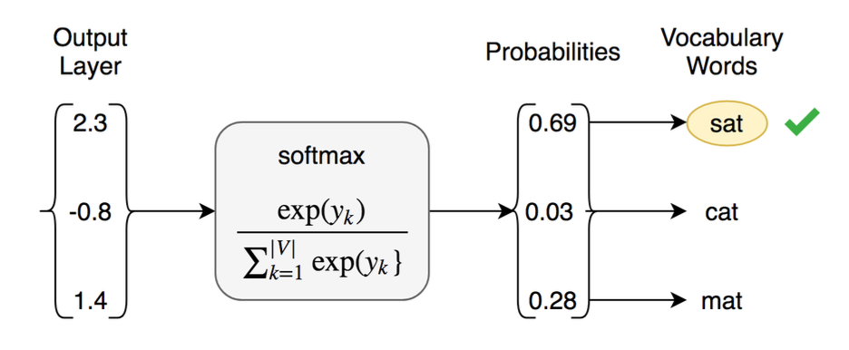
Softmax example
Source: (Bahuleyan, 2018)

Slide 9
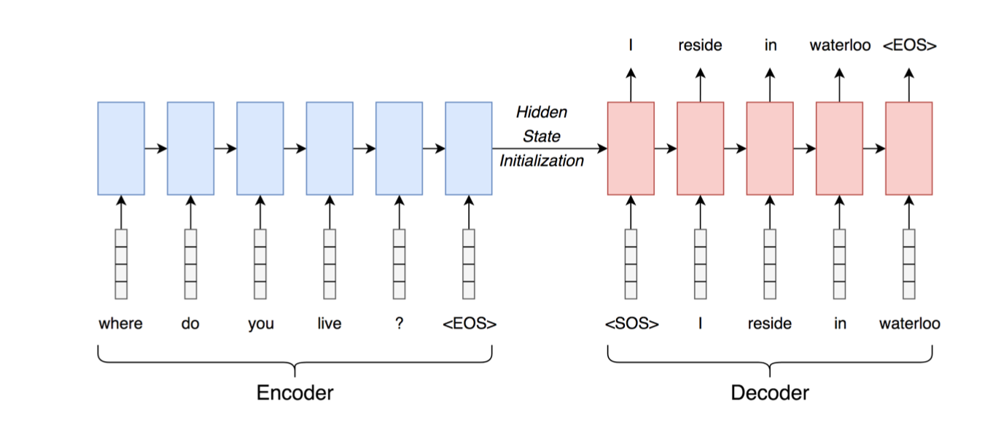
Seq2seq model
Source: (Bahuleyan, 2018)

Slide 10
Selecting the word at each time step of the decoder
Greedy search: select word with the highest p(y_{i}) given by the softmax layer
Beam search: choose k words with the highest p(y_{i}) at each time step.
k – beam width (typically 5-10)

Slide 11
Beam search
Multiple possible replies can be generated in response to “Who does John like?”
Image source: https://www.analyticsvidhya.com/blog/2018/03/essentials-of-deep-learning-sequence-to-sequence-modelling-with-attention-part-i/

Slide 12
Beam search (cont.)
Chose the proposed path with the maximum combined probability
Image source: https://www.analyticsvidhya.com/blog/2018/03/essentials-of-deep-learning-sequence-to-sequence-modelling-with-attention-part-i/

Slide 13
Seq2seq resources
https://blog.keras.io/a-ten-minute-introduction-to-sequence-to-sequence-learning-in-keras.html

Slide 14
Attention mechanism in RNN encoder-decoder networks – Intuitions
Dynamically align target sequence with source sequence in the decoder
Pay different level of attention to words in the input sequence at each time step in the decoder
At each time step, the decoder is provided access to all encoded source tokens
The decoder gives higher weights to certain and lower to others

Slide 15
Attention mechanism – Formal definition
Compute a probabilistic distribution at each decoding time step j
where is the weight given to source output i and
is a pre-normalized score

Slide 16
Attention mechanism – Formal definition (cont.)
Two methods to compute :
Multiplicative (Luong et al., 2015)
Additive (Bahdanau et al., 2014)

Slide 17
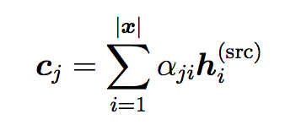
Attention mechanism – Formal definition (cont.)
Take the sum of the source outputs weighted by to get the context vector
Compute attention vector
Finally, feed attention vector to the softmax layer

Slide 18
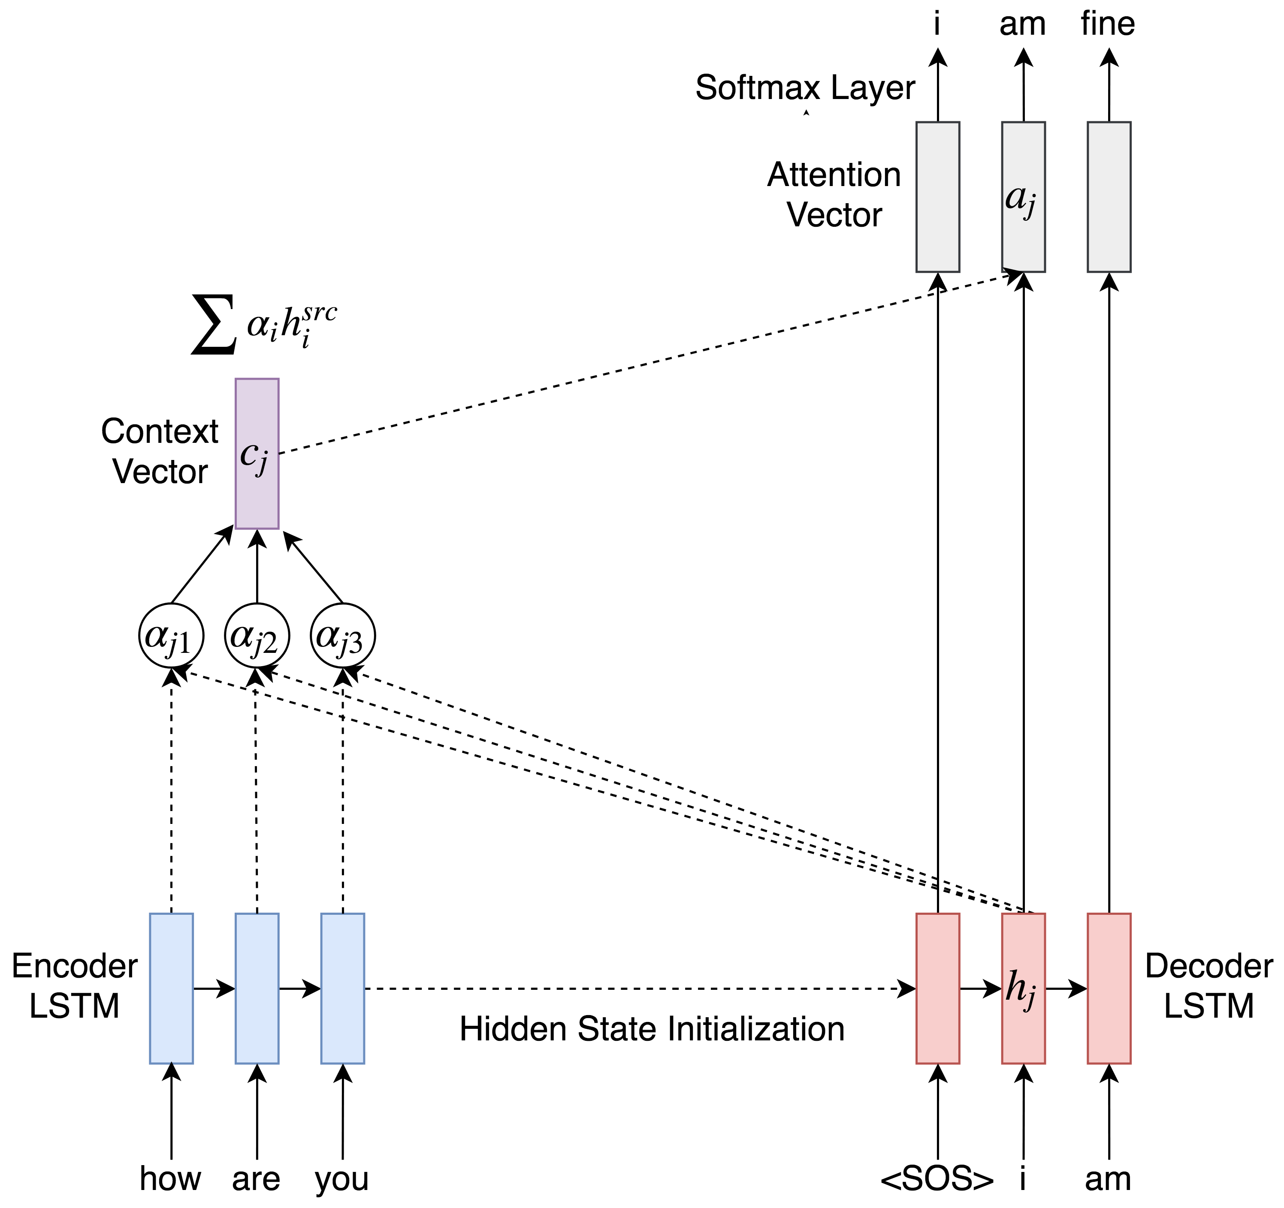
Seq2seq model with attention
Figure source: (Bahuleyan, 2018)

Slide 19
Visualizing Attention in Machine Translation (1)
Source: https://aws.amazon.com/blogs/machine-learning/train-neural-machine-translation-models-with-sockeye/

Slide 20
Visualizing Attention in Machine Translation (2)
Source: https://aws.amazon.com/blogs/machine-learning/train-neural-machine-translation-models-with-sockeye/

Slide 21
Variational Attention for Sequence-to-Sequence Models
Hareesh Bahuleyan, Lili Mou, Olga Vechtomova, Pascal Poupart
In Proc. COLING 2018

Slide 22
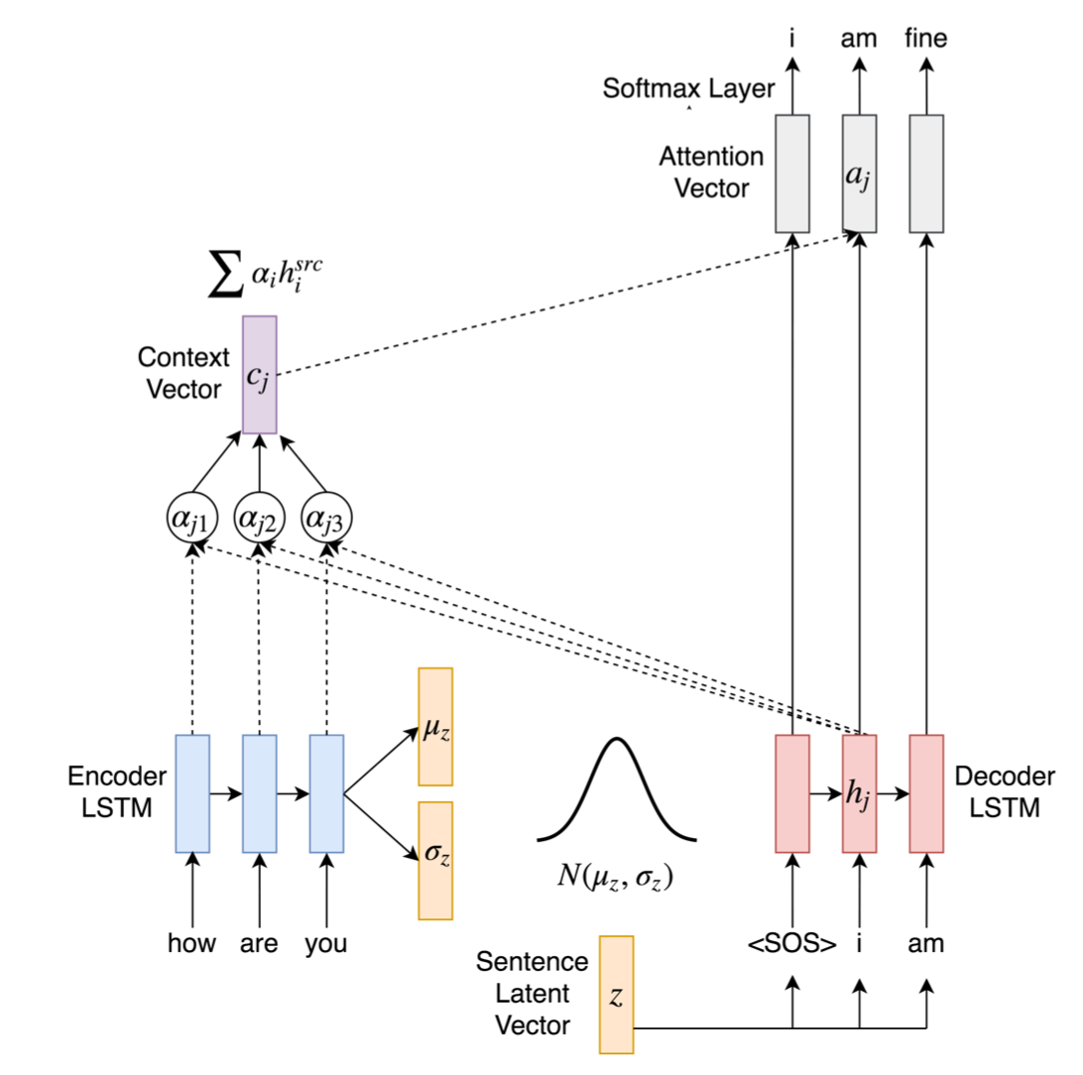
Deterministic Attention in Variational Encoder-Decoder (VED)
The decoder LSTM has direct access to source via c_{j}
This may cause the decoder to ignore z – bypassing phenomenon (Bahuleyan et al., 2018)
Figure source: (Bahuleyan, 2018)

Slide 23
Variational Attention
The context vector c_{j} is modelled as a Gaussian random variable
ELBO for the standard VAE:
ELBO for VAE with variational attention:

Slide 24
Variational Attention (continued)
Given x we can assume conditional independence between z and c_{j}
Hence, the posterior factorizes as
Assume separate priors for z and c_{j}
Sampling is done separately and KL loss can be computed independently

Slide 25
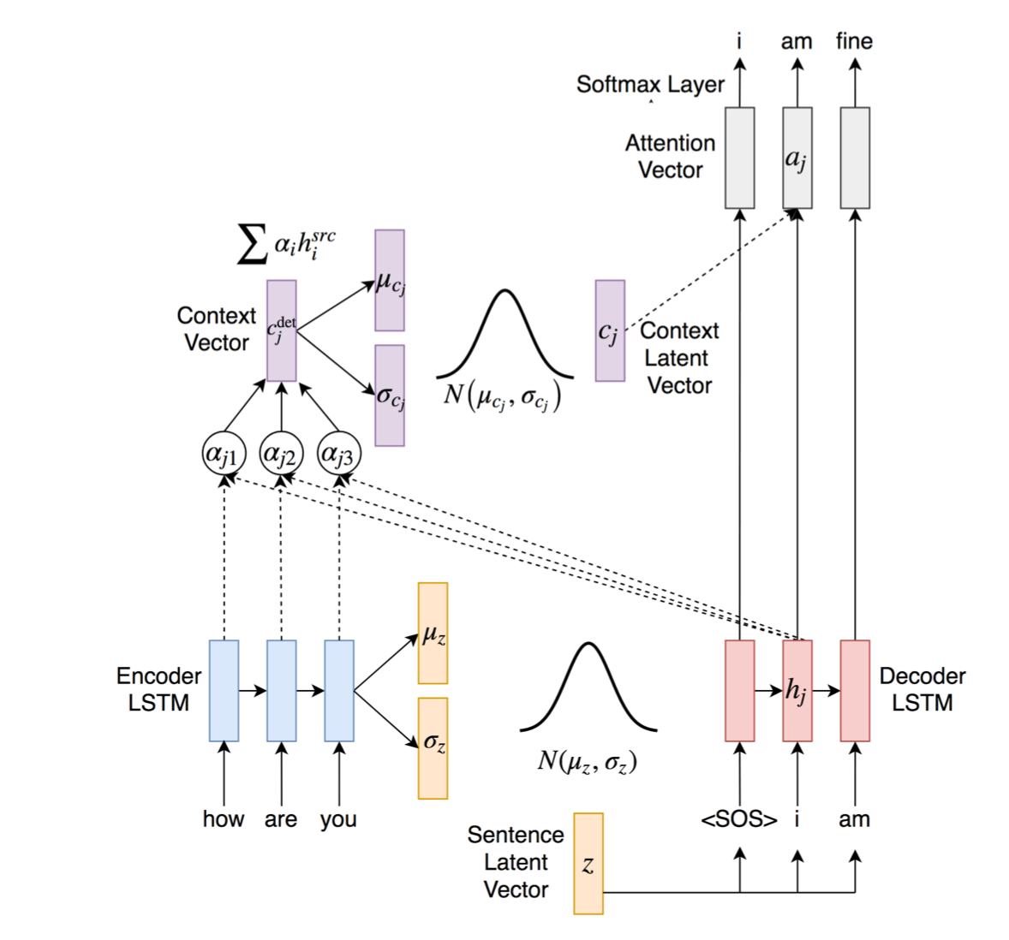
Seq2Seq VED with Variational Attention
Figure source: (Bahuleyan, 2018)

Slide 26
Seq2Seq VED with Variational Attention
Loss function:
𝛌_{KL} – coefficient for both KL terms
𝛄_{𝑎} – coefficient for the context vector’s KL term (kept constant)

Slide 27
Seq2Seq VED with Variational Attention – Prior
Sentence latent code z prior: p(z)=N(0,I) (same as in the VAE)
Context vector c_{j} prior:
Option 1: p(c_{j}) = N(0,I)
Option 2:
where is the mean of the source hidden states
and

Slide 28
Seq2Seq VED with Variational Attention –Posterior
Both posterior distributions q(z|x) and q(c_{j}|x) are parameterized by the encoder LSTM
For the sentence latent space (same as VAE):
For the context vector c_{j} at time step j:
Where , and is computed using feed-forward neural network

Slide 29
Evaluation
Tasks and datasets
Question generation (SQuAD dataset) ~100K QA pairs
Dialogue (Cornell Movie dialogs corpus) >200K conversational exchanges
Evaluation measures:
BLEU scores
Entropy
Distinct
Notes:
-- Entropy. Generate k samples for a given input, and compute entropy of unigram probability distribution.
P(w) = count(w)/total number of tokens
A higher value of entropy corresponds to more randomness in the system.
-- Distinct. The higher the distinct score, the more diverse the output sentences will be.

Slide 30
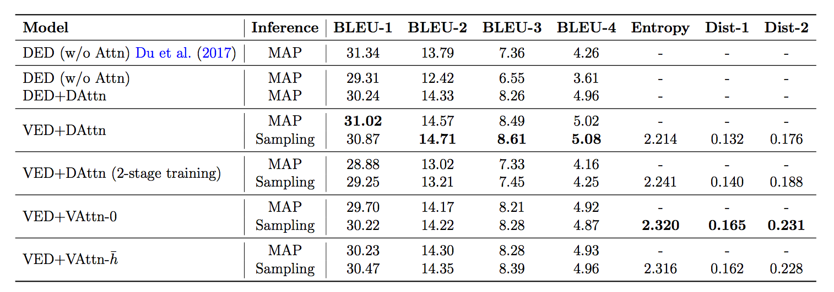
Results on the question generation task
Source: Bahuleyan et al (2018) https://arxiv.org/abs/1712.08207
Notes:
MAP - max a posteriori inference

Slide 31
Results on the conversational (dialogue) system experiment

Slide 32
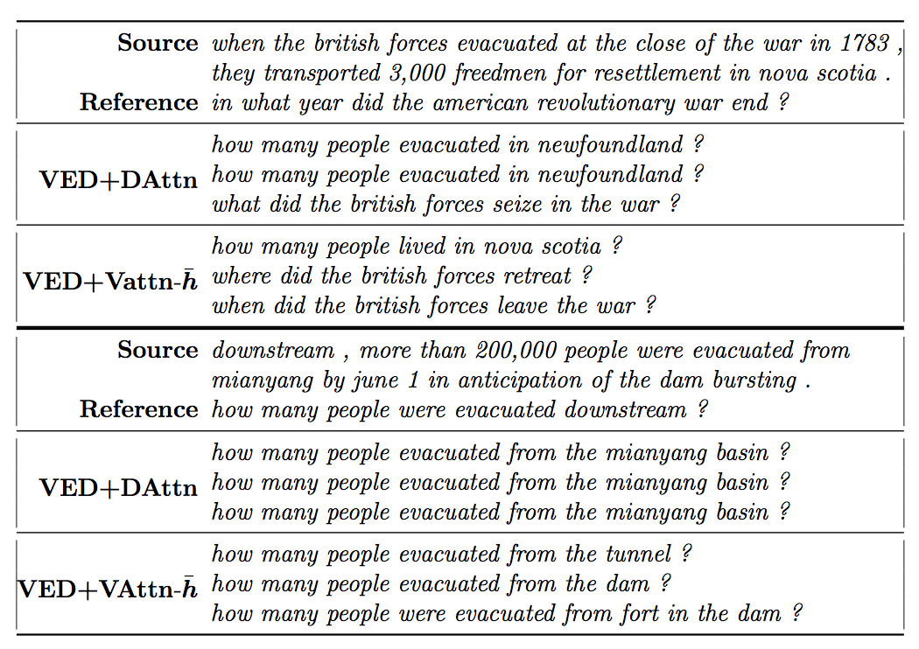
Examples from the question generation task
Source: Bahuleyan et al (2018) https://arxiv.org/abs/1712.08207

