Slide 1
Autoencoders

Slide 2
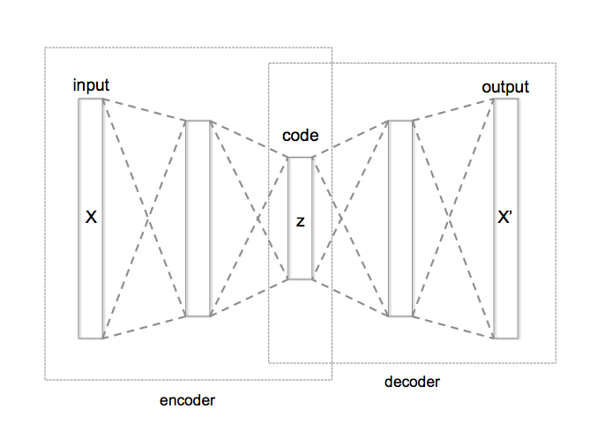
Autoencoder with 3 fully connected layers
Large → small, learn to compress
Source: https://cs.uwaterloo.ca/~mli/Deep-Learning-2017-Lecture7GAN.ppt

Slide 3
Autoencoder with RNNs
LSTMs for the encoder and decoder networks
Can use bi-LSTMs for the encoder (recommended)
The final hidden state of the encoder h_{n} is the latent code z
z is used to initialize the first cell of the decoder

Slide 4
Autoencoder with RNNs
z

Slide 5
Autoencoder with RNNs - training
Reconstruction loss (cross-entropy)
Output h_{i} of every decoder cell i is sent to the softmax classifier
Predict probabilities of words in vocabulary V
Train end-to-end using an optimizer, e.g. SGD or Adam (recommended)
At training time: the decoder receives ground-truth previous word as input at each time step
At inference time: the decoder receives the word predicted at the previous time step

Slide 6
NLP uses of autoencoders
Language modelling
Representation learning
Pre-trained latent space can be used for other tasks, e.g. sentiment classification
Not a generative model, i.e. not suitable for text generation. Why?

Slide 7
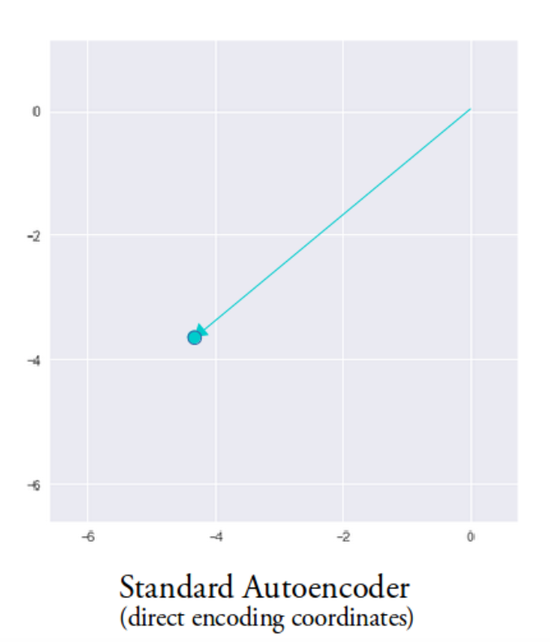
Autoencoder
Encodes input to points in the latent space
Latent space is not continuous
At inference time: can’t sample from the latent space and always get meaningful results
z
Image source: https://towardsdatascience.com/intuitively-understanding-variational-autoencoders-1bfe67eb5daf

Slide 8
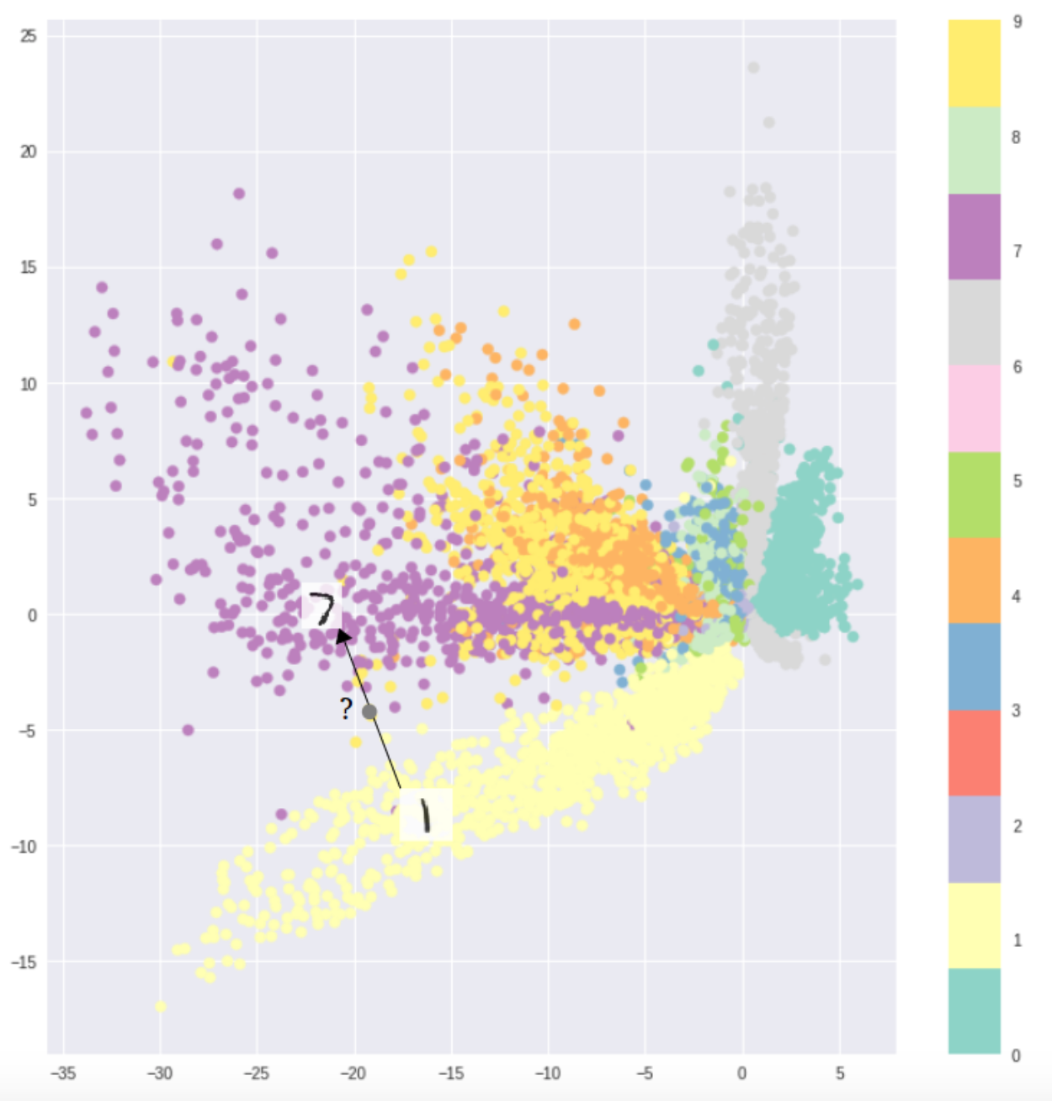
Visualizing the latent space of the deterministic autoencoder
MNIST handwritten digit dataset
Interpolation between two points is not possible
Image source: https://towardsdatascience.com/intuitively-understanding-variational-autoencoders-1bfe67eb5daf

Slide 9
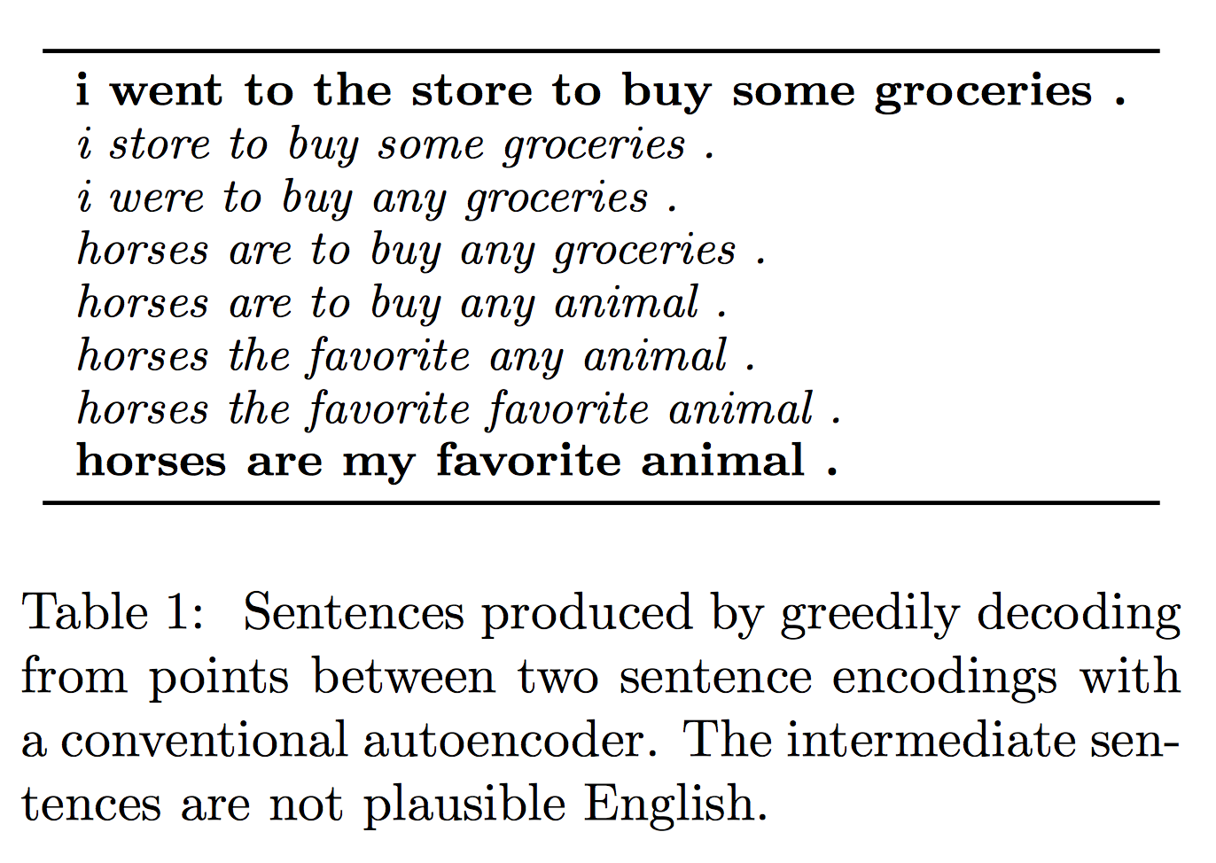
Examples of generated sentences
Source: Bowman and Vilnis, 2016, https://arxiv.org/pdf/1511.06349.pdf

Slide 10
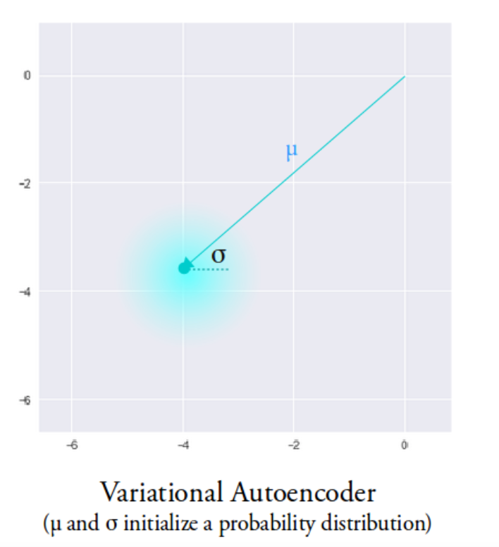
Variational Autoencoder (Kingma and Welling, 2013)
The VAE latent space is continuous
Allows easy random sampling and interpolation
Instead of outputting a vector of size n, the encoder outputs two vectors:
Vector 𝝁 of means (vector size n)
Vector 𝝈 of standard deviations (vector size n)
Output is an approximate posterior distribution q(z|x)
Sample from this distribution to get z
Image source: https://towardsdatascience.com/intuitively-understanding-variational-autoencoders-1bfe67eb5daf

Slide 11
Variational Autoencoder (VAE)
Source: Bowman and Vilnis, 2016, https://arxiv.org/pdf/1511.06349.pdf

Slide 12
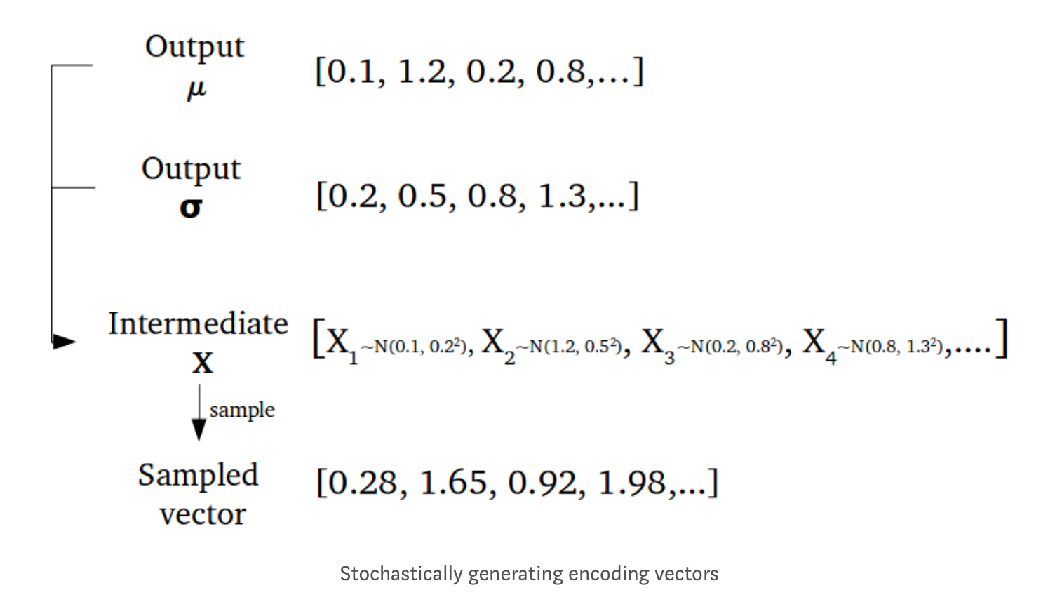
Sampling example
Source: https://towardsdatascience.com/intuitively-understanding-variational-autoencoders-1bfe67eb5daf

Slide 13
VAE Latent Space and Sampling
While the mean and standard deviation are the same for one input, the results are different due to sampling
The encoder can learn to:
Generate different 𝝁 for different classes, clustering them apart
Minimize 𝝈 to ensure that the encodings don’t vary too much

Slide 14
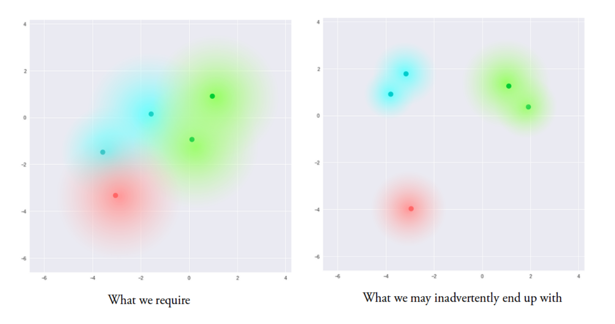
But there is a problem...
Source: https://towardsdatascience.com/intuitively-understanding-variational-autoencoders-1bfe67eb5daf

Slide 15
Solution: Kullback-Leibler divergence
KL divergence is a measure of divergence between two distributions
Minimizing KL divergence means:
Optimizing 𝝁 and 𝝈 of one distribution to resemble 𝝁 and 𝝈 of the target distribution
KL divergence is the sum of KL divergences between the component X_{j}~N(μ_{j}, σ_{j}²) in X, and the standard normal

Slide 16
VAE loss
KL objective is to minimize the divergence between the approximate posterior q(z|x) and the prior p(z)~N(0,I)
VAE total loss = Reconstruction loss (cross-entropy) + KL loss
𝜃 – model parameters

Slide 17
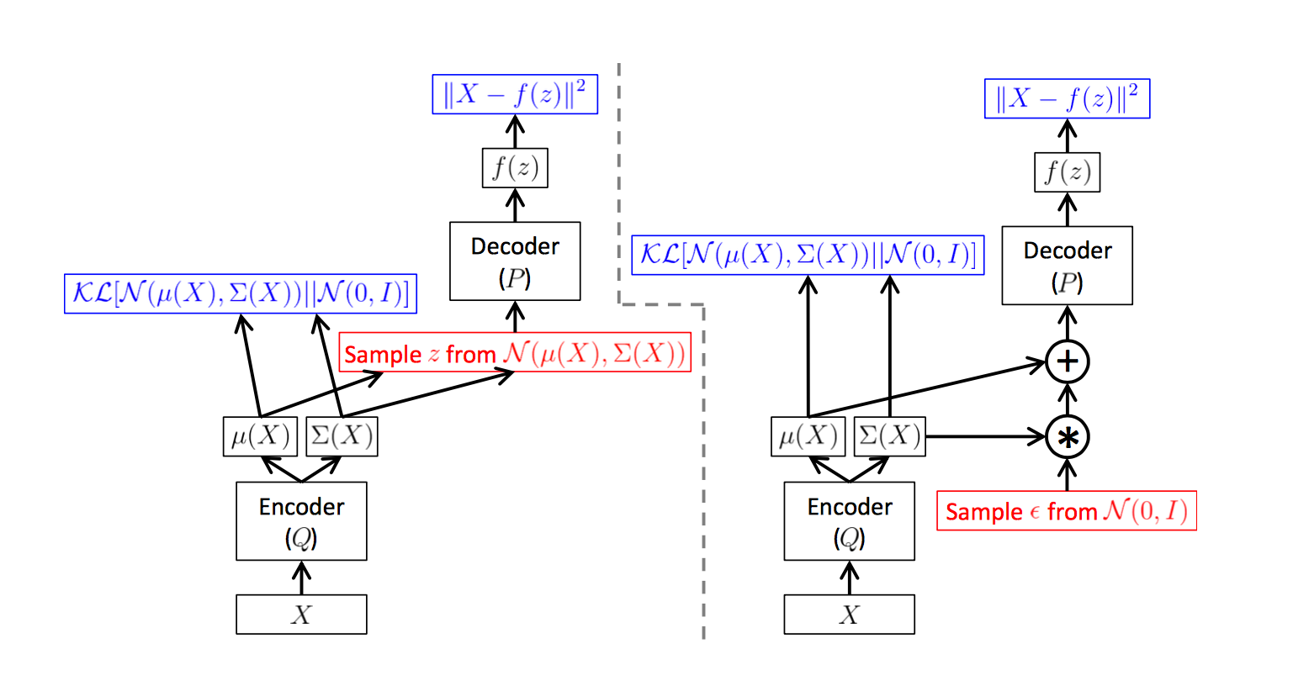
Reparameterization trick
Source: C. Doersch “Tutorial on Variational Autoencoders” (https://arxiv.org/pdf/1606.05908.pdf)
Notes:
A training-time variational autoencoder implemented as a feed-forward neural network, where P(X|z) is Gaussian. Left is without the“reparameterization trick”, and right is with it. Red shows sampling operations that are non-differentiable. Blue shows loss layers. The feedforward behavior of these networks is identical, but backpropagation can be applied only to the right network.

Slide 18
Visualizing the VAE latent space
MNIST handwritten digit dataset
Smooth interpolation between two points is possible
Image source: https://towardsdatascience.com/intuitively-understanding-variational-autoencoders-1bfe67eb5daf

Slide 19
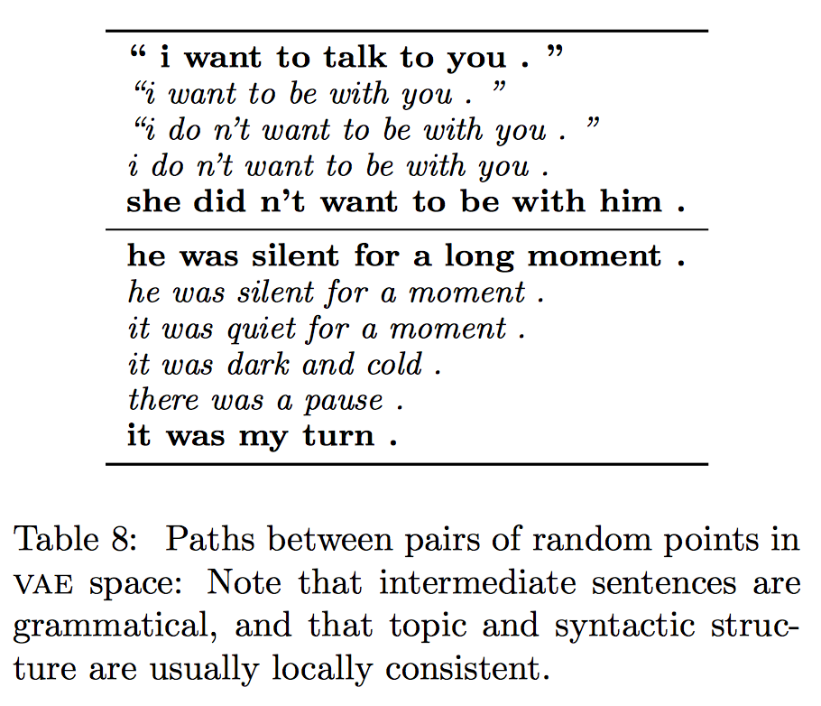
Interpolation between sentences
Source: Bowman and Vilnis, 2016, https://arxiv.org/pdf/1511.06349.pdf

Slide 20
VAE optimization challenges
Successfully trained model should have:
non-zero KL term
small cross-entropy term
Straightforward implementation fails to achieve this
KL term drops to zero
What are the consequences?

Slide 21
Strategies
KL cost annealing
Introduce 𝝀 - weight of the KL term
Anneal lambda slowly from 0 to n<1 up to m iterations (e.g. 3000)
Try different annealing schedules, e.g. from (Bahuleyan et al. 2018):
Word dropout in the decoder input
Ground-truth previous word is input to the decoder during training
Word dropout probability (e.g. 0.5), i.e. half of the time feed <UNK> token.
What is the intuition?

Slide 22
Other VAE design considerations
Concatenate sampled z with input to every cell of the decoder
Slowly increase word dropout probability in the decoder, e.g. at 0.05 rate per epoch (Bahuleyan, 2018)
Add L2 regularization term

Slide 23
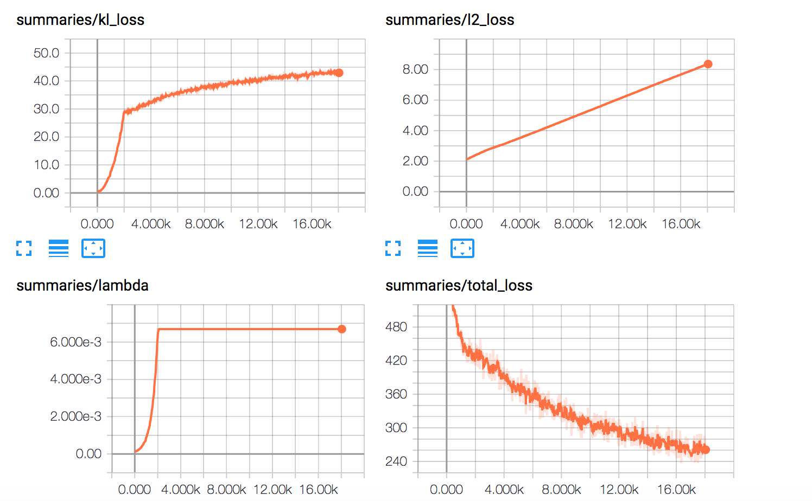
VAE losses plots
Adam optimizer;
KL term annealed till 3000 iterations;
Word dropout p=0.5 annealed at 0.05 rate

Slide 24
Evaluation

Slide 25
BLEU
Bilingual Evaluation Understudy (Papineri et al, 2002)
Automatic measure to evaluate correspondence between the true data (reference text) and the output (generated text).
N-gram overlap between the output and true data
Compute precision for n-grams of size 1 to 4 (BLEU-1, BLEU-2, etc.)
Add brevity penalty (for generated texts that are too short)
Source: http://www.statmt.org/book/slides/08-evaluation.pdf

Slide 26
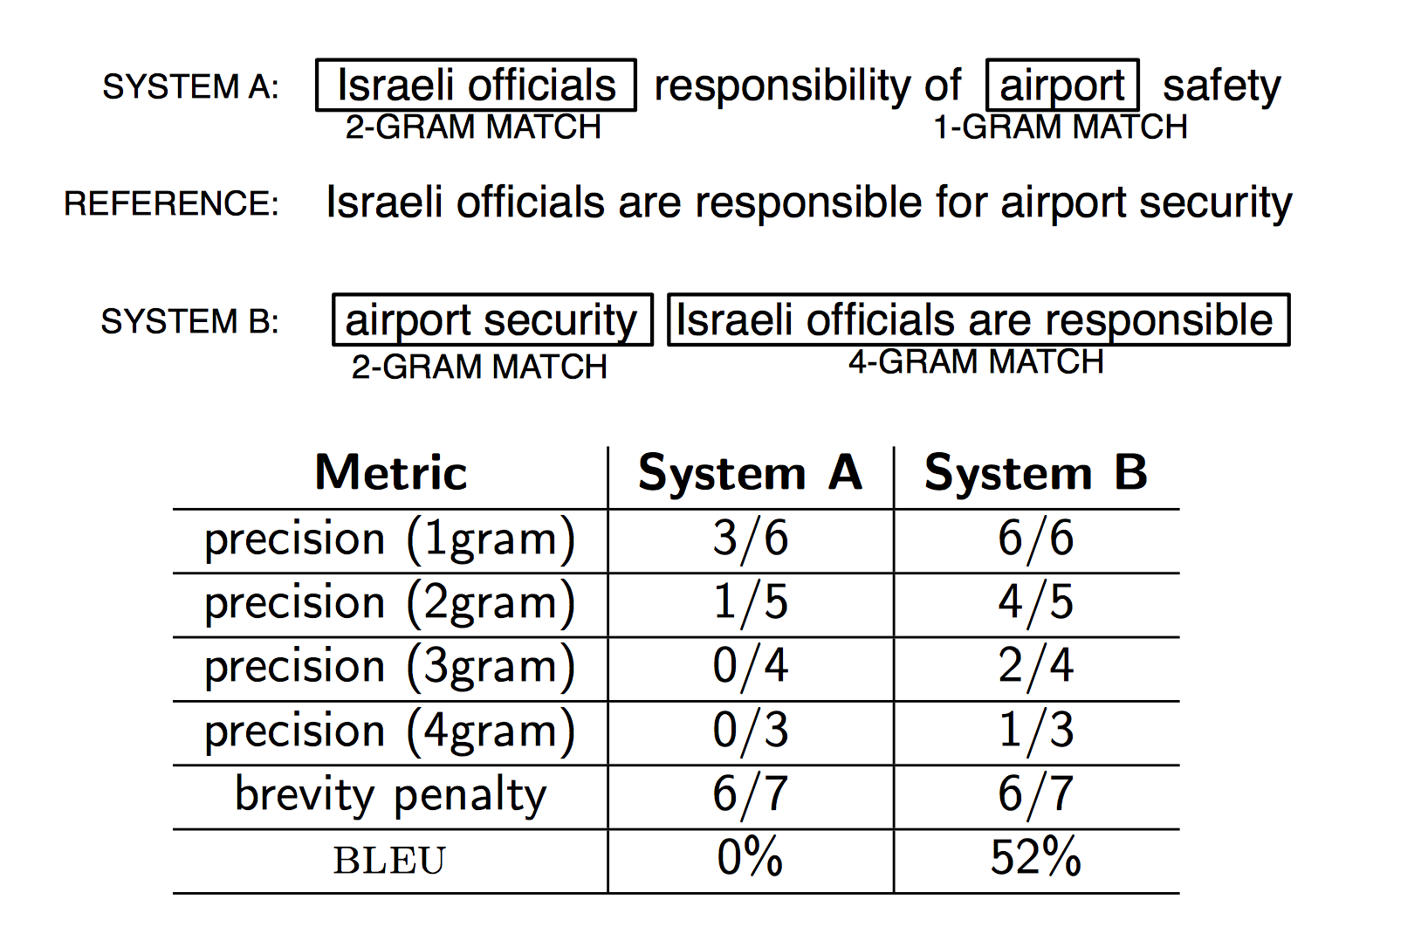
Example (BLEU-4)
Source: http://www.statmt.org/book/slides/08-evaluation.pdf

Slide 27
More on BLEU
Tutorial on how to calculate BLEU in Python:
https://machinelearningmastery.com/calculate-bleu-score-for-text-python/

Slide 28
Variational Inference

Slide 29
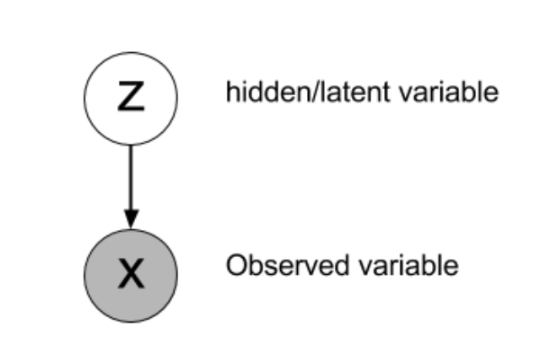
Variational inference
likelihood of the observation X given Z
Latent variable model:
X – observed data, Z – latent variable
prior
Notes:
A latent variable model (a probability distribution over two sets of variables).

Slide 30
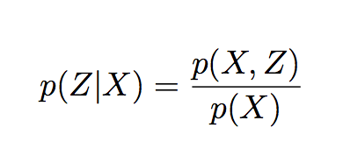
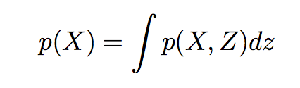
Variational inference
Variational inference problem:
Computing marginal distribution of the data:
Intractable in many cases
posterior distribution
evidence
Notes:
A latent variable model (a probability distribution over two sets of variables).

Slide 31
Approximate posterior
Goal of variational inference: find approximate posterior distribution similar to the true posterior distribution
KL divergence measures how two distributions diverge
Discrete:
Continuous:
Minimize the KL divergence between the approximate posterior distribution Q(Z) and the true posterior distribution P(Z)
Notes:
Find an approximate distribution from a family of distributions, which is similar to the posterior we wish to estimate.

Slide 32
Approximate posterior
From a family of distributions 𝜏 find a distribution Q(Z) that minimizes KL divergence with the true posterior distribution P(Z|X):
Can’t optimize directly because of P(Z|X)
[1]

Slide 33
Re-write Eq. 1 as:
Re-arrange:
[2]
Evidence Lower Bound (ELBO)
log evidence
[3]
Notes:
Log evidence is constant with respect to q(Z)

Slide 34
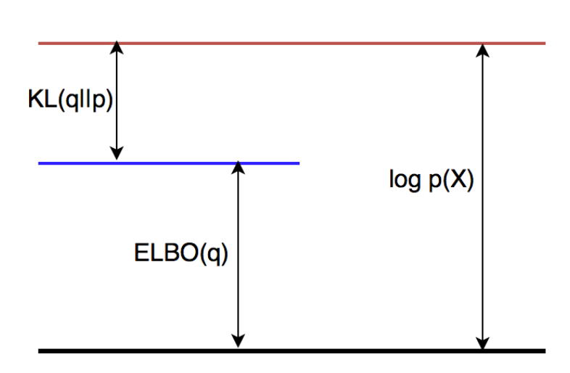
Evidence Lower Bound (ELBO)
Image source: (Bahuleyan, 2018)
Notes:
The objective of minimizing KL divergence is equivalent to maximizing the variational lower bound

Slide 35
Evidence Lower Bound (ELBO)
ELBO can be re-written as:
Maximize expected log likelihood of data and minimize KL divergence
[4]
Expected log likelihood of the data
KL divergence between the approximate posterior and the prior

Slide 36
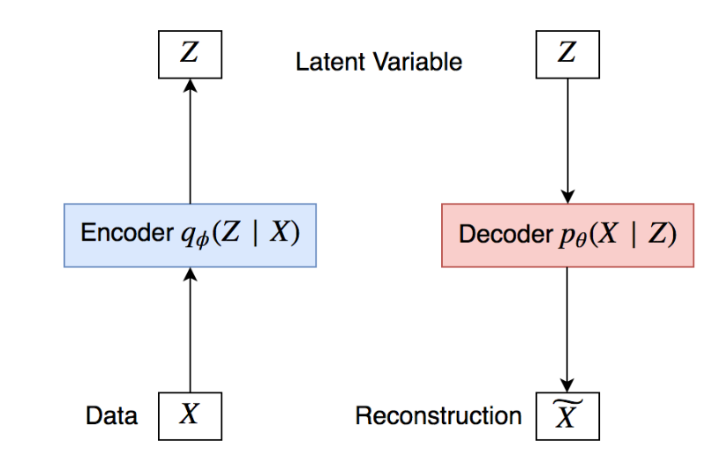
Variational Autoencoder
Image source: (Bahuleyan, 2018)

Slide 37
Variational Autoencoder
Replace approximate posterior q(Z) with q_{𝜑}(Z|X)
Given a dataset:
The likelihood of a data point (log evidence) and ELBO are related as follows:
[5]
Notes:
Compare with Eq. 4.

Slide 38
Variational Autoencoder
Maximizing ELBO(q) is equivalent to minimizing –ELBO(q)
Loss function for the VAE:
Reconstruction loss: expected negative log likelihood of the data
Prior is typically Gaussian N(0,I)
Notes:
Reconstruction loss: expected negative log likelihood of the data

Slide 39
Credits and references
Hareesh Bahuleyan, Lili Mou, Olga Vechtomova, Pascal Poupart. 2018. Variational attention for sequence-to-sequence models. In Proc. COLING 2018.
Hareesh Bahuleyan. 2018. Natural Language Generation with Neural Variational Models. Technical Report. University of Waterloo.
Samuel R Bowman, Luke Vilnis, Oriol Vinyals, Andrew M Dai, Rafal Jozefowicz, and Samy Bengio. 2016.Generating sentences from a continuous space. In Proc. CoNLL 2016.
Carl Doersch. 2016. Tutorial on Variational Autoencoders. arXiv preprint: https://arxiv.org/pdf/1606.05908.pdf
Diederik P Kingma and Max Welling. 2014. Auto-encoding variational bayes. In Proc. ICLR.
Irhum Shafkat. Intuitively Understanding Variational Autoencoders. https://towardsdatascience.com/intuitively-understanding-variational-autoencoders-1bfe67eb5daf. Accessed: June 29, 2018.

