Slide 1
Convolutional Neural Networks

Slide 2
Convolutional Neural Networks
[LeNet-5, LeCun 1980]

Slide 3
Convolution Layer
32x32x3 image
32
height
32
width
3
depth

Slide 4
Convolution Layer
32x32x3 image
5x5x3 filter
32
Convolve the filter with the image
i.e. “slide over the image spatially, computing dot products”
32
3

Slide 5
Convolution Layer
Filters always extend the full depth of the input volume
32x32x3 image
5x5x3 filter
32
Convolve the filter with the image
i.e. “slide over the image spatially, computing dot products”
32
3

Slide 6
Convolution Layer
32x32x3 image
5x5x3 filter
32
1 number:
the result of taking a dot product between the filter and a small 5x5x3 chunk of the image
(i.e. 5*5*3 = 75-dimensional dot product + bias)
32
3

Slide 7
Convolution Layer
activation map
32x32x3 image
5x5x3 filter
32
28
convolve (slide) over all spatial locations
32
28
3
1

Slide 8
consider a second, green filter
Convolution Layer
32x32x3 image
5x5x3 filter
activation maps
32
28
convolve (slide) over all spatial locations
32
28
3
1

Slide 9
For example, if we had 6 5x5 filters, we’ll get 6 separate activation maps:
activation maps
32
28
Convolution Layer
32
28
3
6
We stack these up to get a “new image” of size 28x28x6!

Slide 10
Preview: ConvNet is a sequence of Convolution Layers, interspersed with activation functions
32
28
CONV,
ReLU
e.g. 6 5x5x3 filters
32
28
3
6

Slide 11
Preview: ConvNet is a sequence of Convolutional Layers, interspersed with activation functions
32
28
24
….
CONV,
ReLU
e.g. 6 5x5x3 filters
CONV,
ReLU
e.g. 10 5x5x6 filters
CONV,
ReLU
32
28
24
3
6
10

Slide 12
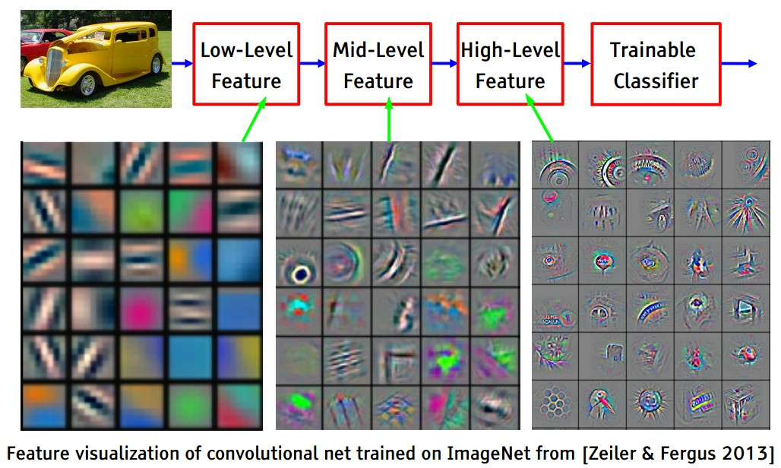
Preview
[FromYann LeCun slides]

Slide 13
Preview
[From recent Yann LeCun slides]

Slide 14
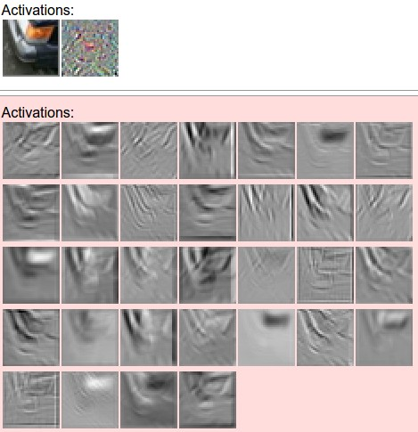
one filter =>
one activation map
example 5x5 filters
(32 total)
We call the layer convolutional because it is related to convolution of two signals:
elementwise multiplication and sum of a filter and the signal (image)

Slide 15
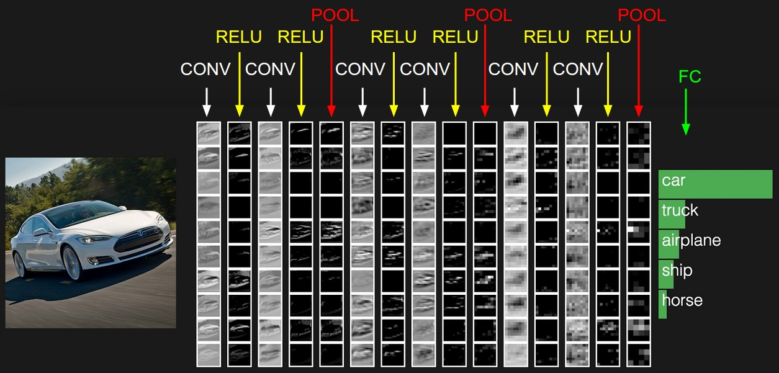
preview:

Slide 16
A closer look at spatial dimensions:
activation map
32x32x3 image
5x5x3 filter
32
28
convolve (slide) over all spatial locations
32
28
3
1

Slide 17
A closer look at spatial dimensions:
7
7x7 input (spatially)
assume 3x3 filter
7

Slide 18
A closer look at spatial dimensions:
7
7x7 input (spatially)
assume 3x3 filter
7

Slide 19
A closer look at spatial dimensions:
7
7x7 input (spatially)
assume 3x3 filter
7

Slide 20
A closer look at spatial dimensions:
7
7x7 input (spatially)
assume 3x3 filter
7

Slide 21
A closer look at spatial dimensions:
7
7x7 input (spatially)
assume 3x3 filter
=> 5x5 output
7

Slide 22
A closer look at spatial dimensions:
7
7x7 input (spatially)
assume 3x3 filter
applied with stride 2
7

Slide 23
A closer look at spatial dimensions:
7
7x7 input (spatially)
assume 3x3 filter
applied with stride 2
7

Slide 24
A closer look at spatial dimensions:
7
7x7 input (spatially)
assume 3x3 filter
applied with stride 2
=> 3x3 output!
7

Slide 25
A closer look at spatial dimensions:
7
7x7 input (spatially)
assume 3x3 filter
applied with stride 3?
7

Slide 26
A closer look at spatial dimensions:
7
7x7 input (spatially)
assume 3x3 filter
applied with stride 3?
7
doesn’t fit!
cannot apply 3x3 filter on 7x7 input with stride 3.

Slide 27
N
Output size:
(N - F) / stride + 1
e.g. N = 7, F = 3:
stride 1 => (7 - 3)/1 + 1 = 5
stride 2 => (7 - 3)/2 + 1 = 3
stride 3 => (7 - 3)/3 + 1 = 2.33 :\
F
N
F

Slide 28
In practice: Common to zero pad the border
0 | 0 | 0 | 0 | 0 | 0
0
0
0
0
e.g. input 7x7
3x3 filter, applied with stride 1
pad with 1 pixel border => what is the output?
(recall:)
(N - F) / stride + 1

Slide 29
In practice: Common to zero pad the border
0 | 0 | 0 | 0 | 0 | 0
0
0
0
0
e.g. input 7x7
3x3 filter, applied with stride 1
pad with 1 pixel border => what is the output?
7x7 output!

Slide 30
In practice: Common to zero pad the border
0 | 0 | 0 | 0 | 0 | 0
0
0
0
0
e.g. input 7x7
3x3 filter, applied with stride 1
pad with 1 pixel border => what is the output?
7x7 output!
in general, common to see CONV layers with stride 1, filters of size FxF, and zero-padding with (F-1)/2. (will preserve size spatially)
e.g. F = 3 => zero pad with 1
F = 5 => zero pad with 2
F = 7 => zero pad with 3

Slide 31
Remember back to…
E.g. 32x32 input convolved repeatedly with 5x5 filters shrinks volumes spatially!
(32 -> 28 -> 24 ...). Shrinking too fast is not good, doesn’t work well.
32
28
24
….
CONV,
ReLU
e.g. 6 5x5x3 filters
CONV,
ReLU
e.g. 10 5x5x6 filters
CONV,
ReLU
32
28
24
3
6
10

Slide 32
Examples time:
Input volume: 32x32x3
10 5x5 filters with stride 1, pad 2
Output volume size: ?

Slide 33
Examples time:
Input volume: 32x32x3
10 5x5 filters with stride 1, pad 2
Output volume size:
(32+2*2-5)/1+1 = 32 spatially, so
32x32x10

Slide 34
Examples time:
Input volume: 32x32x3
10 5x5 filters with stride 1, pad 2
Number of parameters in this layer?

Slide 35
Examples time:
Input volume: 32x32x3
10 5x5 filters with stride 1, pad 2
Number of parameters in this layer?
each filter has 5*5*3 + 1 = 76 params (+1 for bias)
=> 76*10 = 760

Slide 36
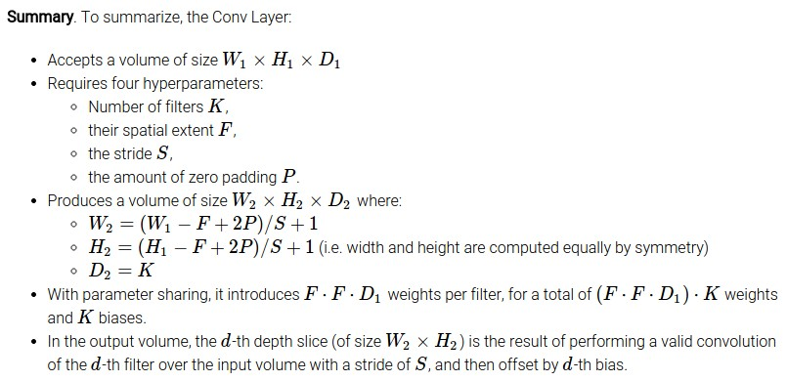

Slide 37
Common settings:
K = (powers of 2, e.g. 32, 64, 128, 512)
F = 3, S = 1, P = 1
F = 5, S = 1, P = 2
F = 5, S = 2, P = ? (whatever fits)
F = 1, S = 1, P = 0

Slide 38
(btw, 1x1 convolution layers make perfect sense)
1x1 CONV
with 32 filters
56
56
(each filter has size 1x1x64, and performs a 64-dimensional dot product)
56
56
64
32

Slide 39
two more layers to go: POOL/FC

Slide 40
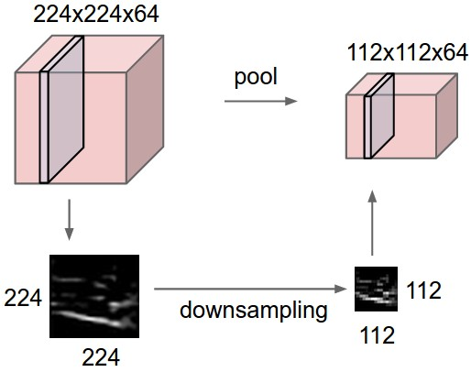
Pooling layer
makes the representations smaller and more manageable
operates over each activation map independently:

Slide 41
MAX POOLING
Single depth slice
1 | 1 | 2 | 4
5 | 6 | 7 | 8
3 | 2 | 1 | 0
1 | 2 | 3 | 4
x
max pool with 2x2 filters and stride 2
6 | 8
3 | 4
y

Slide 42
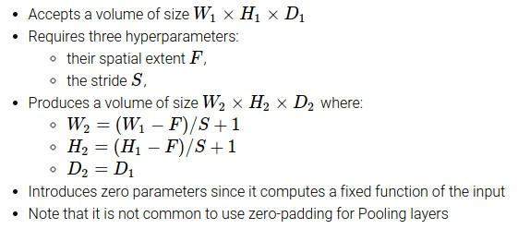

Slide 43
Common settings:
F = 2, S = 2
F = 3, S = 2

Slide 44
Fully Connected Layer (FC layer)
Contains neurons that connect to the entire input volume, as in ordinary Neural Networks

Slide 45
[ConvNetJS demo: training on CIFAR-10]
http://cs.stanford.edu/people/karpathy/convnetjs/demo/cifar10.html

Slide 46
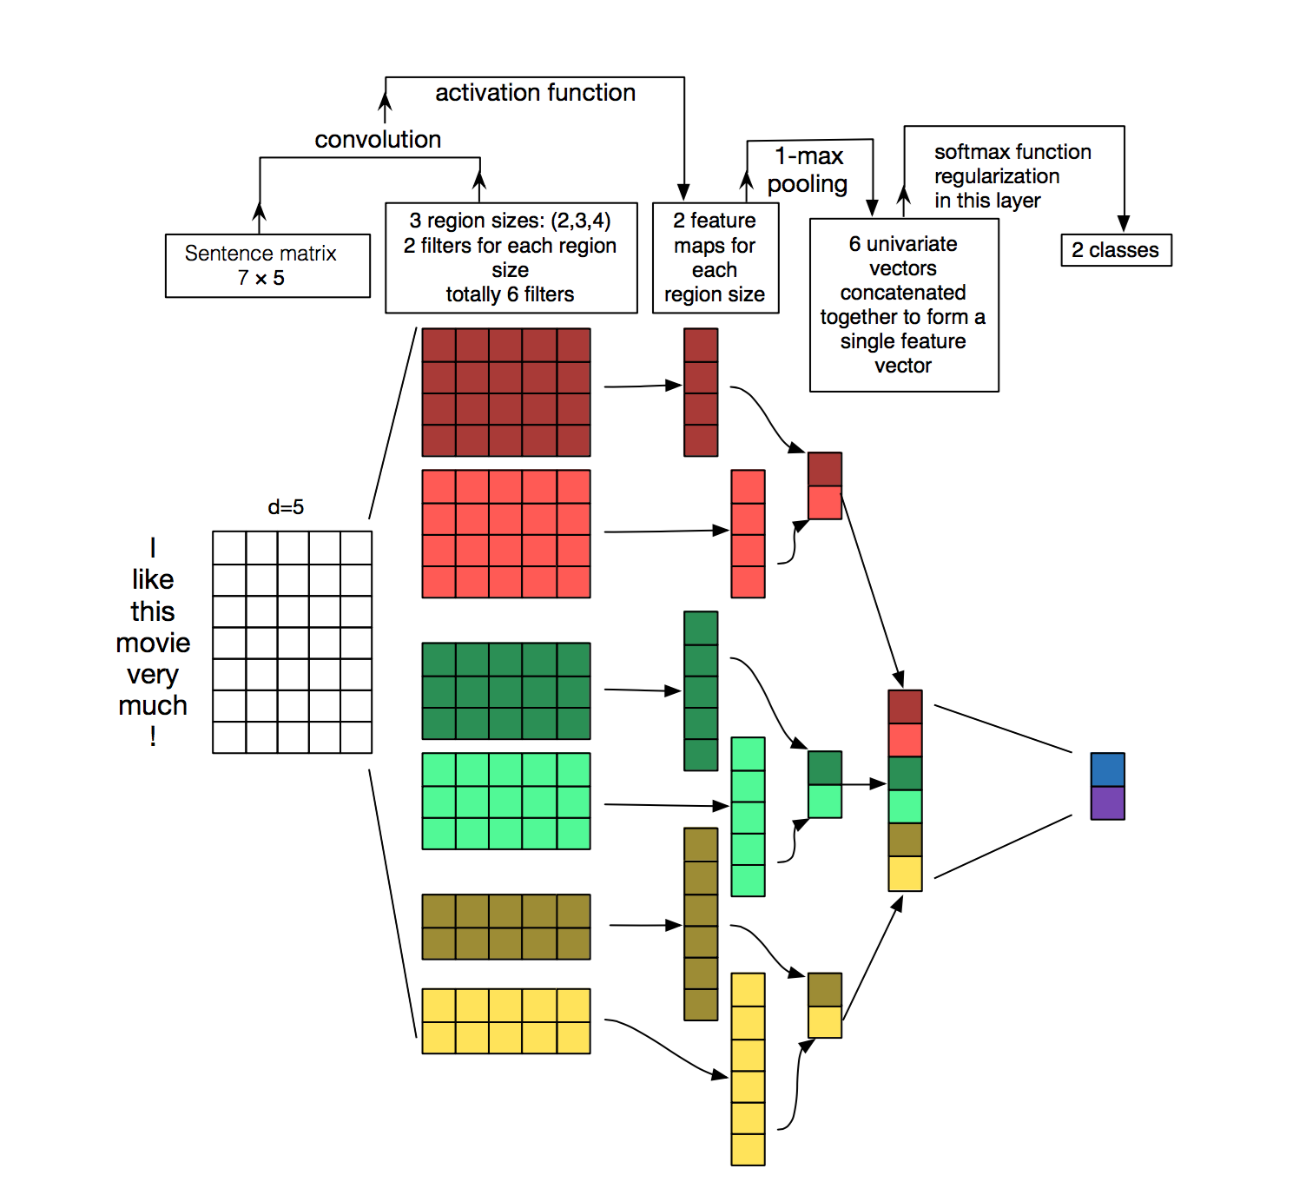
CNNs for NLP
Source: http://www.wildml.com/2015/11/understanding-convolutional-neural-networks-for-nlp/

Slide 47
Single Layer CNN – Single Filter
We compute a single filter for a window size of n (here n=3): Word Vectors: Weight Matrix: Bias:
$$\left(0.8\right)$$
$$\left(\begin{matrix}1 \\ 1\end{matrix}\right)$$
$$\left(\begin{matrix}7 \\ 3\end{matrix}\right)$$
$$\left(\begin{matrix}2 \\ 5\end{matrix}\right)$$
$$\left(\begin{matrix}1 \\ 9\end{matrix}\right)$$
$$\left(\begin{matrix}3 \\ 3\end{matrix}\right)$$
$$\left(\begin{matrix}1 \\ 1\end{matrix}\right)$$
PAD The movie was awesome PAD
Notes:
W ∈ ℝ^{1 x nd}, where n – filter size, d – size of the word embedding vector, here 2.

Slide 48
Single Layer CNN – Single Filter
Compute the output for all windows of size n (in our case n=3)
For each window use the same weight and bias values (shared weights)
This gives us the same number of digits as the length of the sentence
$$\left(0.5\right)$$
$$\left(0.2\right)$$
$$\left(0.6\right)$$
$$\left(0.9\right)$$
$$\left(\begin{matrix}1 \\ 1\end{matrix}\right)$$
$$\left(\begin{matrix}7 \\ 3\end{matrix}\right)$$
$$\left(\begin{matrix}2 \\ 5\end{matrix}\right)$$
$$\left(\begin{matrix}1 \\ 9\end{matrix}\right)$$
$$\left(\begin{matrix}3 \\ 3\end{matrix}\right)$$
$$\left(\begin{matrix}1 \\ 1\end{matrix}\right)$$
PAD The movie was awesome PAD

Slide 49
Single Layer CNN – Pooling Layer
Idea: Capture the most important activation
Let denote the output values for our filter
Compute a max-over-time pooling layer:
Because of max-over-time pooling, length of input sequence is irrelevant.
We could use the output c and forward it to a softmax classifier and derive a sentiment class for the sentence
Max-pooling most common in NLP. In Computer Vision, min-pooling and mean-pooling also common.

Slide 50
Max Pooling vs. Max-over-time
Max-over-time generates fixed-sized output
In NLP, mostly max-over-time is used (as presented by Collobert et al., NLP almost from scratch, section 3.2.2)
A lot of literature on max pooling originated from computer vision
Be careful with different terminology and hyper parameters for those pooling layers
Keras supports both:
MaxPooling1D: for fixed-size max pooling
GlobalMaxPooling1D: for max-over-time pooling

Slide 51
Single Layer CNN + Classification
Negative / Positive
You can train this like any other neural network
Softmax-Classifier
$$\left(0.9\right)$$
$$\left(0.5\right)$$
$$\left(0.2\right)$$
$$\left(0.6\right)$$
$$\left(0.9\right)$$
$$\left(\begin{matrix}1 \\ 1\end{matrix}\right)$$
$$\left(\begin{matrix}7 \\ 3\end{matrix}\right)$$
$$\left(\begin{matrix}2 \\ 5\end{matrix}\right)$$
$$\left(\begin{matrix}1 \\ 9\end{matrix}\right)$$
$$\left(\begin{matrix}3 \\ 3\end{matrix}\right)$$
$$\left(\begin{matrix}1 \\ 1\end{matrix}\right)$$
PAD The movie was awesome PAD

Slide 52
1 Dimension – not enough information
Negative / Positive
With only a single filter our possibilities are limited
Softmax-Classifier
$$\left(0.5\right)$$
$$\left(0.5\right)$$
$$\left(0.2\right)$$
$$\left(−0.2\right)$$
$$\left(−0.9\right)$$
$$\left(\begin{matrix}1 \\ 1\end{matrix}\right)$$
$$\left(\begin{matrix}7 \\ 3\end{matrix}\right)$$
$$\left(\begin{matrix}2 \\ 5\end{matrix}\right)$$
$$\left(\begin{matrix}1 \\ 9\end{matrix}\right)$$
$$\left(\begin{matrix}−3 \\ −3\end{matrix}\right)$$
$$\left(\begin{matrix}1 \\ 1\end{matrix}\right)$$
PAD The movie was horrible PAD

Slide 53
Single Layer CNN – Multiple Filters
Negative / Positive
By changing the dimensionality of the weight matrix, we can add further filters:
Softmax-Classifier
$$\left(\begin{aligned}0.5 \\ 0.8\end{aligned}\right)$$
$$\left(\begin{aligned}0.5 \\ 0.7\end{aligned}\right)$$
$$\left(\begin{aligned}0.2 \\ 0.1\end{aligned}\right)$$
$$\left(\begin{aligned}−0.2 \\ 0.7\end{aligned}\right)$$
$$\left(\begin{aligned}−0.9 \\ 0.8\end{aligned}\right)$$
$$\left(\begin{matrix}1 \\ 1\end{matrix}\right)$$
$$\left(\begin{matrix}7 \\ 3\end{matrix}\right)$$
$$\left(\begin{matrix}2 \\ 5\end{matrix}\right)$$
$$\left(\begin{matrix}1 \\ 9\end{matrix}\right)$$
$$\left(\begin{matrix}−3 \\ −3\end{matrix}\right)$$
$$\left(\begin{matrix}1 \\ 1\end{matrix}\right)$$
PAD The movie was horrible PAD

Slide 54
Going further with Filters
We can create convolutional layers working on unigrams, bigrams, trigrams etc. and combine their output
Softmax-Classifier
$$\left(\begin{aligned}0.1 \\ 0.7\end{aligned}\right)$$
$$\left(\begin{aligned}0.5 \\ 0.8\end{aligned}\right)$$
$$\left(\begin{aligned}0.1 \\ 0.1\end{aligned}\right)$$
$$\left(\begin{aligned}0.0 \\ 0.1\end{aligned}\right)$$
$$\left(\begin{aligned}0.1 \\ 0.1\end{aligned}\right)$$
$$\left(\begin{aligned}−0.8 \\ 0.7\end{aligned}\right)$$
$$\left(\begin{aligned}0.5 \\ 0.7\end{aligned}\right)$$
$$\left(\begin{aligned}0.2 \\ 0.1\end{aligned}\right)$$
$$\left(\begin{aligned}−0.2 \\ 0.7\end{aligned}\right)$$
$$\left(\begin{aligned}−0.9 \\ 0.8\end{aligned}\right)$$
$$\left(\begin{matrix}7 \\ 3\end{matrix}\right)$$
$$\left(\begin{matrix}2 \\ 5\end{matrix}\right)$$
$$\left(\begin{matrix}1 \\ 9\end{matrix}\right)$$
$$\left(\begin{matrix}−3 \\ −3\end{matrix}\right)$$
$$\left(\begin{matrix}1 \\ 1\end{matrix}\right)$$
$$\left(\begin{matrix}7 \\ 3\end{matrix}\right)$$
$$\left(\begin{matrix}2 \\ 5\end{matrix}\right)$$
$$\left(\begin{matrix}1 \\ 9\end{matrix}\right)$$
$$\left(\begin{matrix}−3 \\ −3\end{matrix}\right)$$
$$\left(\begin{matrix}1 \\ 1\end{matrix}\right)$$
The movie was horrible
PAD The movie was horrible PAD

Slide 55
Or work on a different granularity
Softmax-Classifier
$$\left(\begin{aligned}0.7 \\ 0.9\end{aligned}\right)$$
$$\left(\begin{aligned}0.5 \\ 0.8\end{aligned}\right)$$
$$\left(\begin{aligned}0.1 \\ 0.1\end{aligned}\right)$$
$$\left(\begin{aligned}0.0 \\ 0.1\end{aligned}\right)$$
$$\left(\begin{aligned}0.1 \\ 0.1\end{aligned}\right)$$
$$\left(\begin{aligned}0.2 \\ 0.2\end{aligned}\right)$$
$$\left(\begin{aligned}0.6 \\ 0.0\end{aligned}\right)$$
$$\left(\begin{aligned}0.1 \\ 0.9\end{aligned}\right)$$
$$\left(\begin{aligned}0.7 \\ 0.9\end{aligned}\right)$$
$$\left(\begin{aligned}0.5 \\ 0.7\end{aligned}\right)$$
$$\left(\begin{aligned}0.2 \\ 0.1\end{aligned}\right)$$
$$\left(\begin{aligned}−0.2 \\ 0.7\end{aligned}\right)$$
$$\left(\begin{aligned}−0.9 \\ 0.8\end{aligned}\right)$$
$$\left(\begin{matrix}7 \\ 3\end{matrix}\right)$$
$$\left(\begin{matrix}2 \\ 5\end{matrix}\right)$$
$$\left(\begin{matrix}1 \\ 9\end{matrix}\right)$$
$$\left(\begin{matrix}3 \\ 3\end{matrix}\right)$$
$$\left(\begin{matrix}4 \\ 2\end{matrix}\right)$$
$$\left(\begin{matrix}2 \\ 3\end{matrix}\right)$$
$$\left(\begin{matrix}2 \\ 3\end{matrix}\right)$$
$$\left(\begin{matrix}1 \\ 1\end{matrix}\right)$$
$$\left(\begin{matrix}7 \\ 3\end{matrix}\right)$$
$$\left(\begin{matrix}2 \\ 5\end{matrix}\right)$$
$$\left(\begin{matrix}1 \\ 9\end{matrix}\right)$$
$$\left(\begin{matrix}−3 \\ −3\end{matrix}\right)$$
$$\left(\begin{matrix}1 \\ 1\end{matrix}\right)$$
The mov ie was hor rib le
PAD The movie was horrible PAD
Conv. Layer on character trigrams
Conv. Layer on word trigrams

Slide 56
Stacking Convolutional Layers
From character n-grams we could derive vectors for words and then a vector for the sentence
$$\left(\begin{aligned}0.9 \\ 0.4\end{aligned}\right)$$
$$\left(\begin{aligned}0.2 \\ 0.4\end{aligned}\right)$$
$$\left(\begin{aligned}0.9 \\ 0.2\end{aligned}\right)$$
$$\left(\begin{aligned}0.0 \\ 0.3\end{aligned}\right)$$
$$\left(\begin{aligned}0.1 \\ 0.2\end{aligned}\right)$$
$$\left(\begin{aligned}0.2 \\ 0.4\end{aligned}\right)$$
$$\left(\begin{aligned}0.9 \\ 0.1\end{aligned}\right)$$
$$\left(\begin{aligned}0.0 \\ 0.1\end{aligned}\right)$$
$$\left(\begin{aligned}0.1 \\ 0.1\end{aligned}\right)$$
$$\left(\begin{aligned}0.2 \\ 0.2\end{aligned}\right)$$
$$\left(\begin{aligned}0.6 \\ 0.0\end{aligned}\right)$$
$$\left(\begin{matrix}7 \\ 3\end{matrix}\right)$$
$$\left(\begin{matrix}5 \\ 4\end{matrix}\right)$$
$$\left(\begin{matrix}2 \\ 1\end{matrix}\right)$$
$$\left(\begin{matrix}7 \\ 3\end{matrix}\right)$$
$$\left(\begin{matrix}2 \\ 5\end{matrix}\right)$$
$$\left(\begin{matrix}1 \\ 9\end{matrix}\right)$$
$$\left(\begin{matrix}3 \\ 3\end{matrix}\right)$$
$$\left(\begin{matrix}4 \\ 2\end{matrix}\right)$$
#St arW ars
#Aw eso meM ovi e
#StarWars
#AwesomeMovie

Slide 57
How to choose the embeddings?
Rand: Random initialization
Static: word2vec, no updates during training
Non-static: word2vec with updates
Multichannel: next slide
Source: Kim, 2014. Performance on Sentence Classification Tasks

Slide 58
Multi-Channel Idea
We start with 2 copies for the word vectors, both initialized with word2vec/GloVe etc.
Only one version of them is updated, the other is static
We apply the same filters to both channels before we apply the pooling
One channel can learn task specific embeddings
E.g. for sentiment: good and bad should be far away in vector space
So far mixed results
Different Idea: Use differently pre-trained word embeddings
E.g. based on local context, on dependency trees, on relations from knowledge bases etc.
Reference: Kim, 2014. Performance on Sentence Classification Tasks

Slide 59
Credits
These slides have been adapted from
The course by Fei Fei Li and Andrej Karpathy: http://cs231n.stanford.edu/2015/syllabus
The tutorial on deep learning for NLP: https://github.com/UKPLab/deeplearning4nlp-tutorial

