Slide 1
Recurrent Neural Networks

Slide 2
NLP and Sequential Data
NLP is full of sequential data
Words in sentences
Characters in words
Sentences in discourse
…

Slide 3
Long-distance Dependencies in Language
Agreement in number, gender, etc.
He does not have very much confidence in himself.
She does not have very much confidence in herself.
Selectional preference
The reign has lasted as long as the life of the queen.
The rain has lasted as long as the life of the clouds.

Slide 4
Can be Complicated!
What is the referent of “it”?
The trophy would not fit in the brown suitcase because it was too big.
Trophy
The trophy would not fit in the brown suitcase because it was too small.
Suitcase
(from Winograd Schema Challenge:
http://commonsensereasoning.org/winograd.html)

Slide 5
Recurrent Neural Networks
(Elman 1990)
Tools to “remember” information
Feed-forward NN
Recurrent NN
label
label
predict
predict
transform
transform
lookup
lookup
context
context

Slide 6
Recurrent Neural Networks

Slide 7
An unrolled recurrent neural network

Slide 8
Standard RNN

Slide 9
Unrolling in Time
What does processing a sequence look like?
label
label
label
label
predict
predict
predict
predict
RNN
RNN
RNN
RNN
I
hate
this
movie

Slide 10
Training RNNs
sum
total loss
label 1
label 2
label 3
label 4
loss 1
loss 2
loss 3
loss 4
prediction 1
prediction 2
prediction 3
prediction 4
predict
predict
predict
predict
RNN
RNN
RNN
RNN
I
hate
this
movie

Slide 11
RNN Training
The unrolled graph is a well-formed (DAG) computation graph—we can run backprop
Parameters are tied across time, derivatives are aggregated across all time steps
This is historically called “backpropagation through time” (BPTT)
total loss
sum

Slide 12
Parameter Tying
sum
total loss
label 1
label 2
label 3
label 4
loss 1
loss 2
loss 3
loss 4
prediction 1
prediction 2
prediction 3
prediction 4
predict
predict
predict
predict
RNN
RNN
RNN
RNN
I
hate
this
movie
Parameters are shared! Derivatives are accumulated.

Slide 13
Applications of RNNs

Slide 14
What Can RNNs Do?
Represent a sentence
Read whole sentence, make a prediction
Represent a context within a sentence
Read context up until that point

Slide 15
Representing Sentences
prediction
predict
RNN
RNN
RNN
RNN
I
hate
this
movie
Sentence classification
Conditioned generation
Retrieval

Slide 16
Representing Contexts
label
label
label
label
predict
predict
predict
predict
RNN
RNN
RNN
RNN
I
hate
this
movie
Tagging
Language Modeling
Calculating Representations for Parsing, etc.

Slide 17
e.g. Language Modeling
I
hate
this
movie
</s>
predict
predict
predict
predict
predict
RNN
RNN
RNN
RNN
RNN
<s>
I
hate
this
movie
Language modeling is like a tagging task, where each tag is the next word!

Slide 18
Bi-RNNs
A simple extension, run the RNN in both directions
PRN
VB
DET
NN
softmax
softmax
softmax
softmax
concat
concat
concat
concat
RNN
RNN
RNN
RNN
RNN
RNN
RNN
RNN
I
hate
this
movie

Slide 19
Vanishing Gradient
Gradients decrease as they get pushed back
Why? “Squashed” by non-linearities or small weights in matrices.

Slide 20
A Solution: Long Short-term Memory
(Hochreiter and Schmidhuber 1997)
Basic idea: make additive connections between time steps
Addition does not modify the gradient, no vanishing
Gates to control the information flow

Slide 21
Reminder: Standard RNN

Slide 22
LSTM with four interacting layers

Slide 23
The cell state

Slide 24
Gates
sigmoid layer

Slide 25
Step-by-Step LSTM Walk Through

Slide 26
Forget gate layer

Slide 27
Input gate layer

Slide 28
The current state

Slide 29
Output layer

Slide 30
Other Alternatives
Lots of variants of LSTMs (Gers and Schmidhuber, 2000)
Gated recurrent units (GRUs; Cho et al., 2014)
All follow the basic paradigm of “take input, update state”

Slide 31
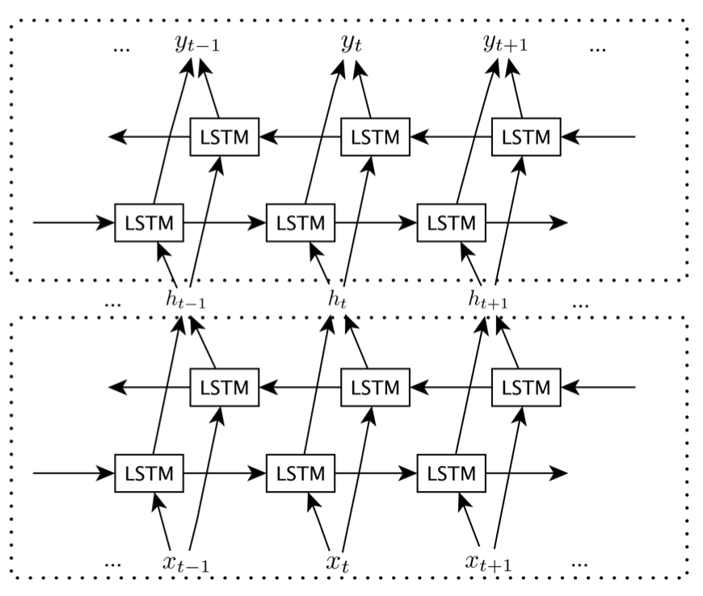
Stacked LSTM (Graves et al. 2013)
Image source: http://www.aclweb.org/anthology/P15-2116

Slide 32
Why adding layers?
In feed-forward NNs:
create new representations at higher levels of abstraction
In RNNs:
chunk observations over time
represent the problem at different time scales
Resources:
Graves et al. 2013 paper: https://arxiv.org/pdf/1303.5778.pdf
Blog by Jason Brownlee: https://machinelearningmastery.com/stacked-long-short-term-memory-networks/

Slide 33
Efficiency/Memory Tricks

Slide 34
Handling Mini-batching
Mini-batching makes things much faster!
But mini-batching in RNNs is harder than in feed-forward networks
Each word depends on the previous word
Sequences are of various length

Slide 35
Mini-batching Method
this is an example </s>
this is another </s>
</s>
Padding
Loss
Calculation
1 1
1 1
1 1
1 1
1 0
Mask
Take Sum

Slide 36
Bucketing/Sorting
If we use sentences of different lengths, too much padding and masking can result in decreased performance
To remedy this: sort sentences so similarly-lengthed sentences are in the same batch

Slide 37
Handling Long Sequences
Sometimes we would like to capture long-term dependencies over long sequences
e.g. words in full documents
However, this may not fit on (GPU) memory

Slide 38
Truncated BPTT
Backprop over shorter segments, initialize w/ the state from the previous segment
RNN
RNN
RNN
RNN
1st Pass
It
is
so
bad
state only, no backprop
RNN
RNN
RNN
RNN
2nd Pass
I
hate
this
movie

Slide 39
Pre-training/Transfer for RNNs

Slide 40
RNN Strengths/Weaknesses
RNNs, particularly deep RNNs/LSTMs, are quite powerful and flexible
But they require a lot of data
Also have trouble with weak error signals passed back from the end of the sentence

Slide 41
Pre-training/Transfer
Train for one task, solve another
Pre-training task: Big data, easy to learn
Main task: Small data, harder to learn

Slide 42
Example: LM -> Sentence Classifier
Dai and Le (2015) https://arxiv.org/pdf/1511.01432.pdf
Train a language model first: lots of data, easy-to-learn objective
Sentence classification: little data, hard-to-learn objective
Results in much better classifications, competitive or better than CNN-based methods

Slide 43
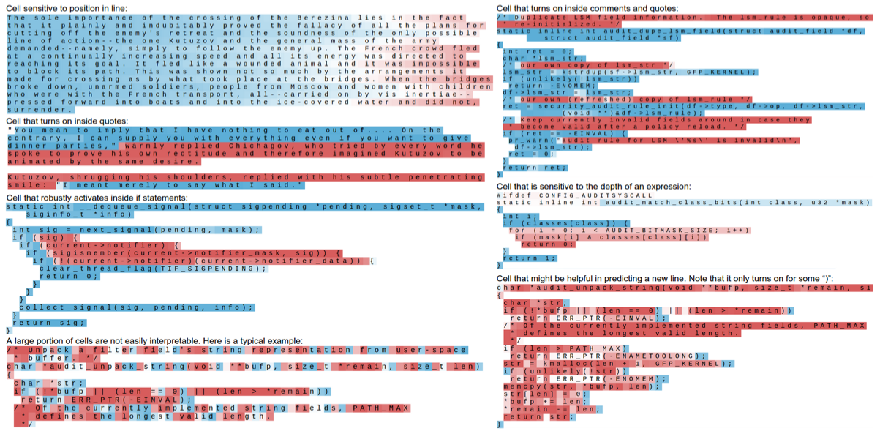
Why Pre-training?
The model learns consistencies in the data (Karpathy et al. 2015) _
Model learns syntax (Shi et al. 2017) or semantics (Radford et al. 2017)

Slide 44
Recurrent Neural Networks:
Process Sequences

Slide 45
Recurrent Neural Networks: Process Sequences
e.g. Image Captioning
image -> sequence of words

Slide 46
Recurrent Neural Networks: Process Sequences
e.g. Sentiment Classification
sequence of words -> sentiment

Slide 47
Recurrent Neural Networks: Process Sequences
e.g. Machine Translation
seq of words -> seq of words

Slide 48
Recurrent Neural Networks: Process Sequences
e.g. Tagging, e.g. Named Entity (NE) or POS tagging

Slide 49
Credits
These slides were adapted from
the course by Graham Neubig: https://phontron.com/class/nn4nlp2017/
and Christopher Olah’s blog: http://colah.github.io/posts/2015-08-Understanding-LSTMs/
Stanford’s CS231n course: http://cs231n.stanford.edu/slides/2017/cs231n_2017_lecture10.pdf

