Slide 1

Neural Networks Introduction
Lecture 2 -
1

Slide 2
Linear classification

Slide 3
Linear Classification
1. define a score function
Class scores:
negative
positive
neutral
I loved this movie.
Lecture 2 -
3
Fei-Fei Li & Andrej Karpathy Lecture 2 - 7 Jan 2015

Slide 4

Linear Classification
1. define a score function
data (sentence representation)
“bias vector”
“weights”
class scores
“parameters”
Lecture 2 -
4
Fei-Fei Li & Andrej Karpathy Lecture 2 - 7 Jan 2015

Slide 5
Linear Classification
1. define a score function
data (sentence representation)
bias vector
weights
class scores
Lecture 2 -
5

Slide 6
Linear Classification
1. define a score function
data (sentence representation)
[300 x 1]
bias vector [3 x 1]
weights
[3 x 300]
class scores [3 x 1]
Lecture 2 -
6

Slide 7
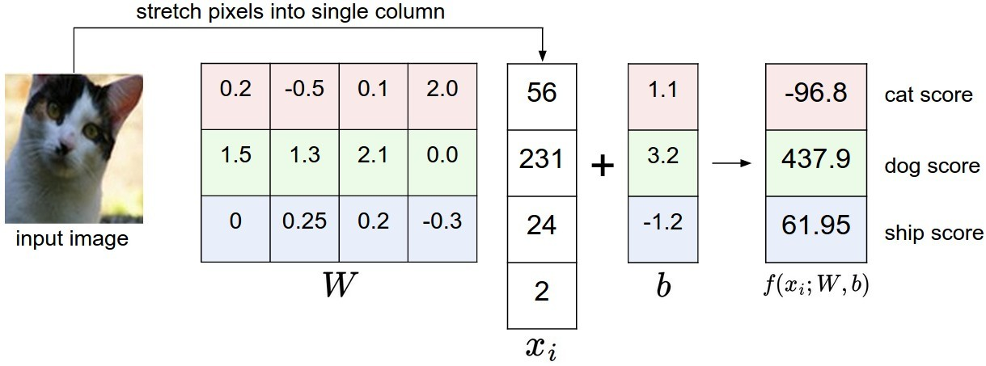
Linear Classification
represent sentence as vector
negative
positive
neutral
I loved this
movie.
input
sentence
7

Slide 8
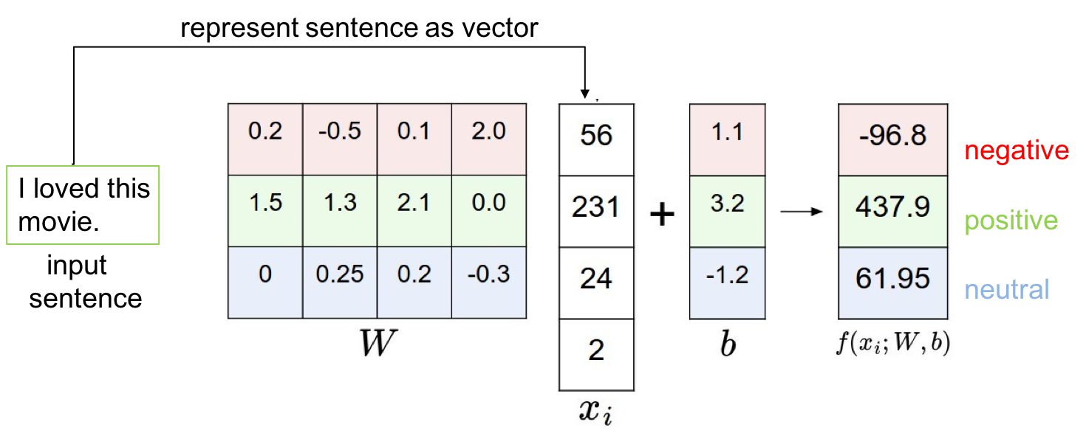
Interpreting a Linear Classifier
Question:
what can a linear classifier do?
Lecture 2 -
8
Fei-Fei Li & Andrej Karpathy Lecture 2 - 7 Jan 2015

Slide 9
Interpreting a Linear Classifier
I loved this movie.
Awful.
Not too bad.
Terrible movie.
Awesome.
Will never see it again.
A must see.
0
Negative
Will see it again.
Mediocre
performance.
Realistic play.
Positive
Modern take on
an old classic.
In cinemas until May.
Neutral
Saw it yesterday.

Slide 10
So far:
We defined a (linear) score function:

Slide 11

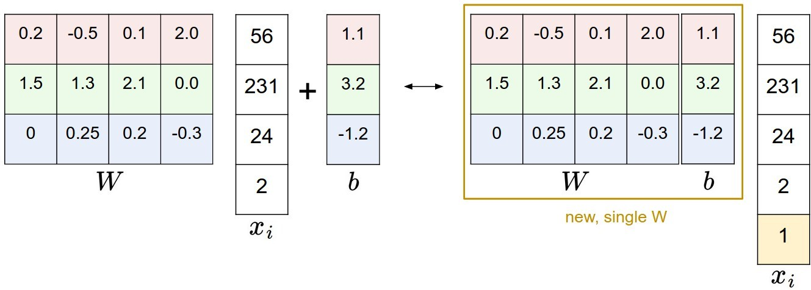
Bias trick

Slide 12
2. Define a loss function (or cost function, or objective)
Fei-Fei Li & Andrej Karpathy Lecture 2 - 7 Jan 2015

Slide 13



2. Define a loss function (or cost function, or objective)
scores, label loss.
Fei-Fei Li & Andrej Karpathy Lecture 2 - 7 Jan 2015

Slide 14


2. Define a loss function (or cost function, or objective)
scores, label loss.
Example:
Fei-Fei Li & Andrej Karpathy Lecture 2 - 7 Jan 2015

Slide 15
2. Define a loss function (or cost function, or objective)
- scores, label loss.
Example:
Question: if you were to assign a single number to how “unhappy” you are with these scores, what would you do?
Fei-Fei Li & Andrej Karpathy Lecture 2 - 7 Jan 2015

Slide 16
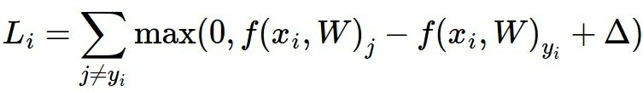
2. Define a loss function (or cost function, or objective)
One (of many ways) to do it: Multiclass SVM Loss
Fei-Fei Li & Andrej Karpathy Lecture 2 - 7 Jan 2015

Slide 17
2. Define a loss function (or cost function, or objective)
One (of many ways) to do it: Multiclass SVM Loss
(One possible generalization of Binary Support Vector Machine to multiple classes)
Fei-Fei Li & Andrej Karpathy Lecture 2 - 7 Jan 2015

Slide 18
2. Define a loss function (or cost function, or objective)
One (of many ways) to do it: Multiclass SVM Loss
loss due to example i
difference between the correct class
sum over all
_{incorrect labels} score and incorrect class score
Fei-Fei Li & Andrej Karpathy Lecture 2 - 7 Jan 2015

Slide 19

loss due to example i
difference between the correct class
sum over all
_{incorrect labels} score and incorrect class score
Fei-Fei Li & Andrej Karpathy Lecture 2 - 7 Jan 2015

Slide 20
Example:
e.g. 10
loss = ?
Fei-Fei Li & Andrej Karpathy Lecture 2 - 7 Jan 2015

Slide 21
Example:
e.g. 10
Fei-Fei Li & Andrej Karpathy Lecture 2 - 7 Jan 2015

Slide 22


There is a bug with the objective…
Fei-Fei Li & Andrej Karpathy Lecture 2 - 7 Jan 2015

Slide 23


L2 Regularization
Regularization strength
Fei-Fei Li & Andrej Karpathy Lecture 2 - 7 Jan 2015

Slide 24




L2 regularization: motivation

Slide 25
So far…
1. Score function
2. Loss function
Fei-Fei Li & Andrej Karpathy Lecture 2 - 7 Jan 2015

Slide 26
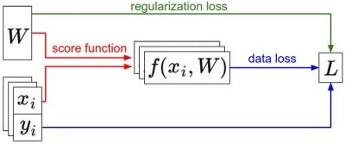
Fei-Fei Li & Andrej Karpathy Lecture 2 - 7 Jan 2015

Slide 27
Neural networks

Slide 28
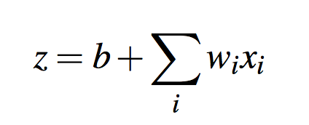

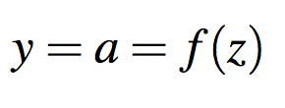
Neural unit
Weighted sum of inputs plus a bias term:
Or in vector notation:
Apply non-linear function:
Output of this function is the activation value a for this unit

Slide 29
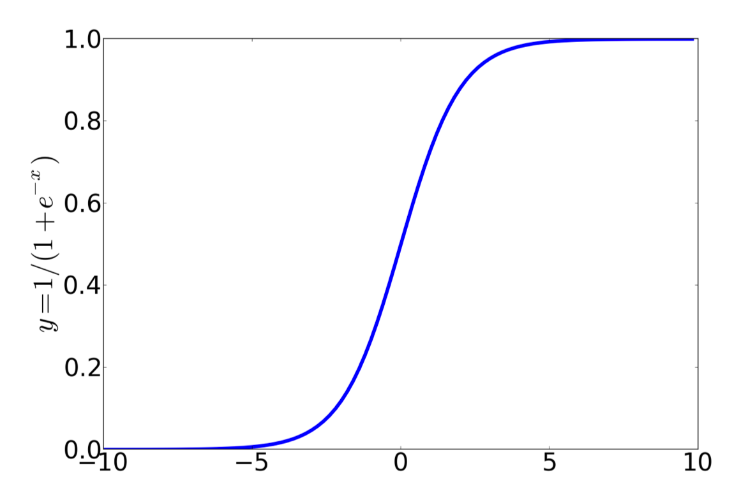
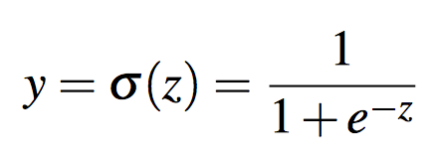
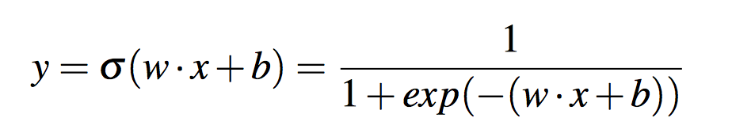
Activation functions
Sigmoid function

Slide 30
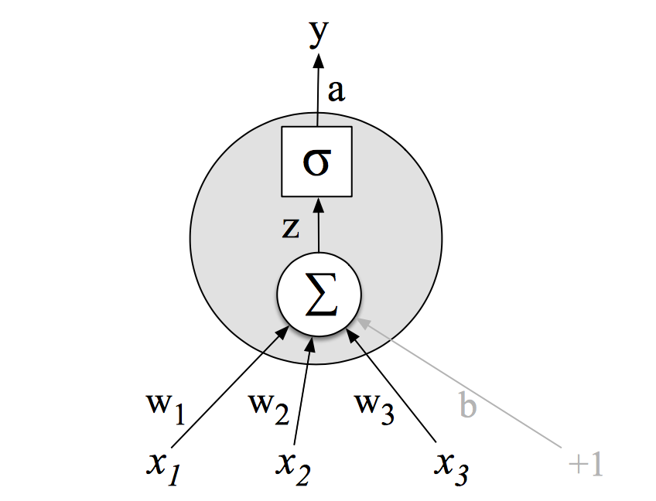
Neural unit with sigmoid activation function

Slide 31
Example
w = [0.2, 0.3, 0.9] b = 0.5
Input vector x = [0.5, 0.6, 0.1]

Slide 32
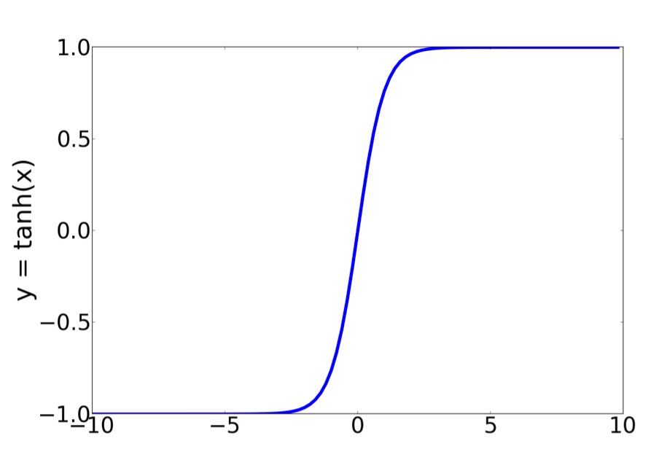
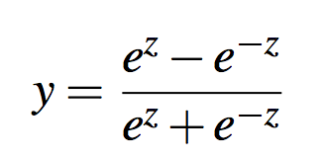
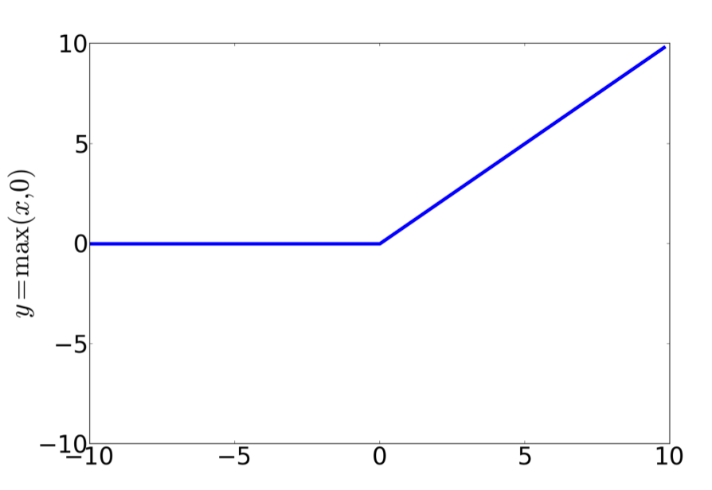
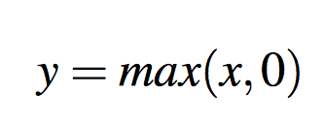
Other non-linear functions
tanh function
Rectified linear units (ReLU)

Slide 33
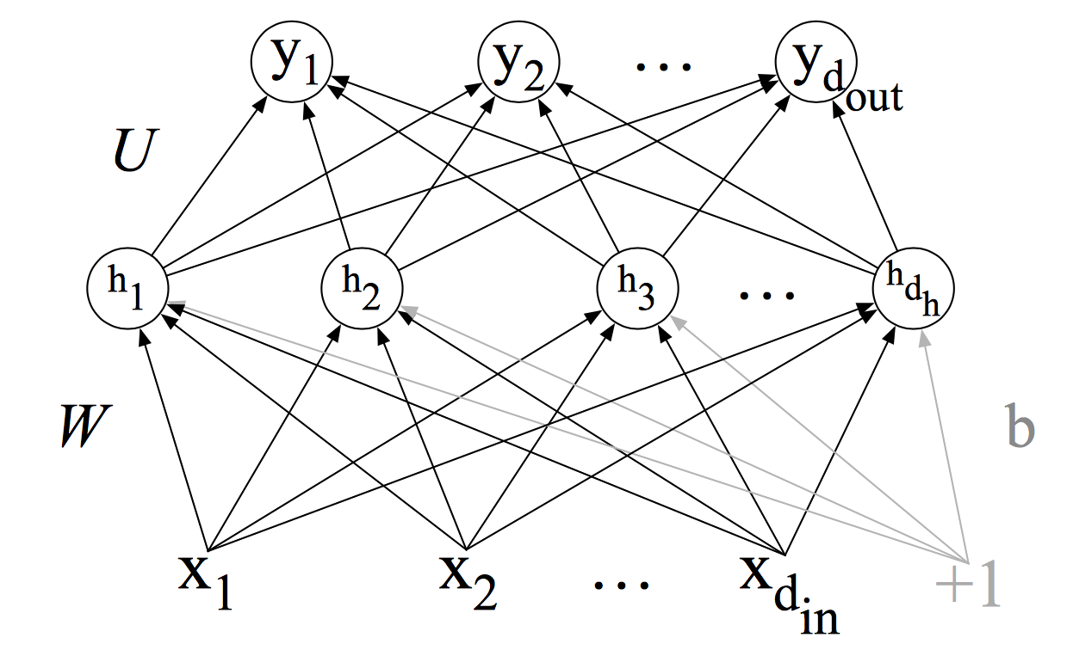
Feed-Forward Neural Networks
Multilayer fully-connected network with no cycles
Three kinds of nodes: input units, hidden units and output units

Slide 34
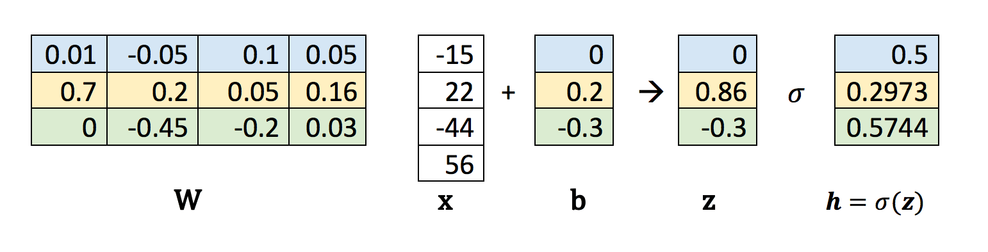
Computation as matrix operations
x ∈ ℝ^{din}
h ∈ ℝ^{dh}
b ∈ ℝ^{dh}
W ∈ ℝ^{din x dh}

Slide 35
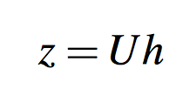
Output layer
Binary classification
  Single output unit (e.g. positive-negative sentiment).
  Output value: probability of positive or negative sentiment
Multinomial classification:
  One node for each class
  Output: probability distribution
U – weight matrix
d^{out} nodes, z ∈ ℝ^{dout}, U ∈ ℝ^{dout x dh}
z can’t be the output of the classifier. Why?

Slide 36
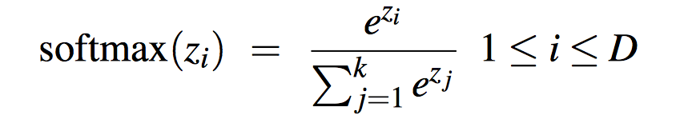
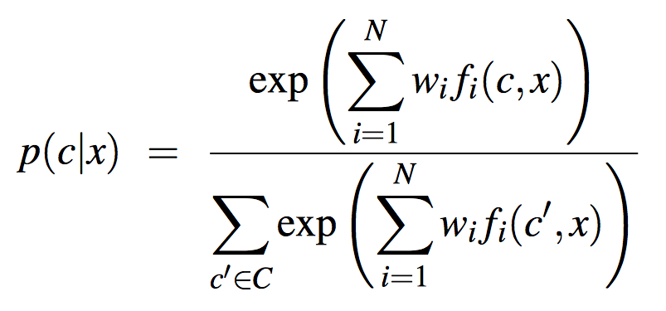
Softmax function
Function for normalizing a vector of real values
Outputs a vector encoding a probability distribution
Used in multinomial logistic regression:

Slide 37
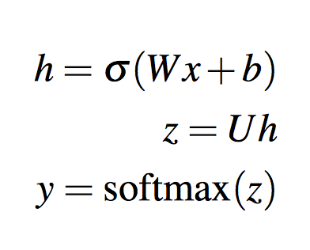
Summing it up

Slide 38
Training neural networks
Use optimization methods, e.g. stochastic gradient descent
𝜽 – all the parameters we need to learn (W and b for each layer)
Intuition:
  start with some initial values of 𝜽 (e.g. random)
  then nudge the weights in a direction that improves our system
Loss function measures the distance between the system output and the gold (true) data.
or

Slide 39
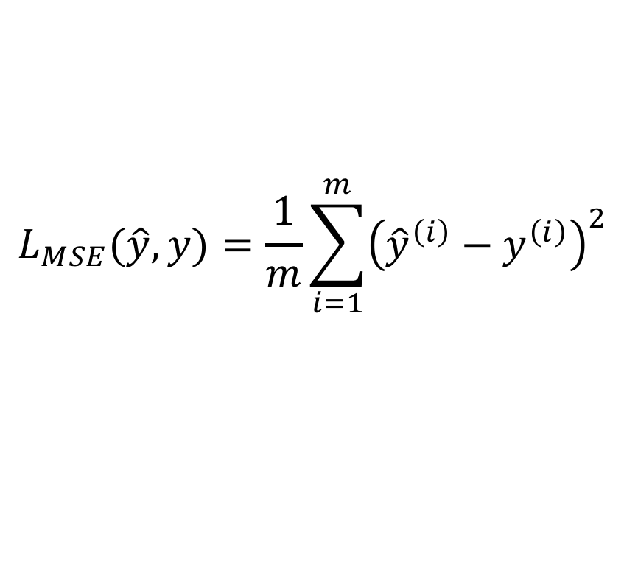

Mean Squared Error (MSE)
MSE between the true value $y^{\left(i\right)}$ and the system’s output ${\hat{y}}^{\left(i\right)}$ averaged over m observations
$$L_{MSE}(\hat{y},y)=\frac{1}{m}\sum_{i=1}^{m}{{\left({\hat{y}}^{\left(i\right)}−y^{\left(i\right)}\right)}^{2}}$$

Slide 40
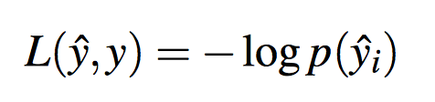
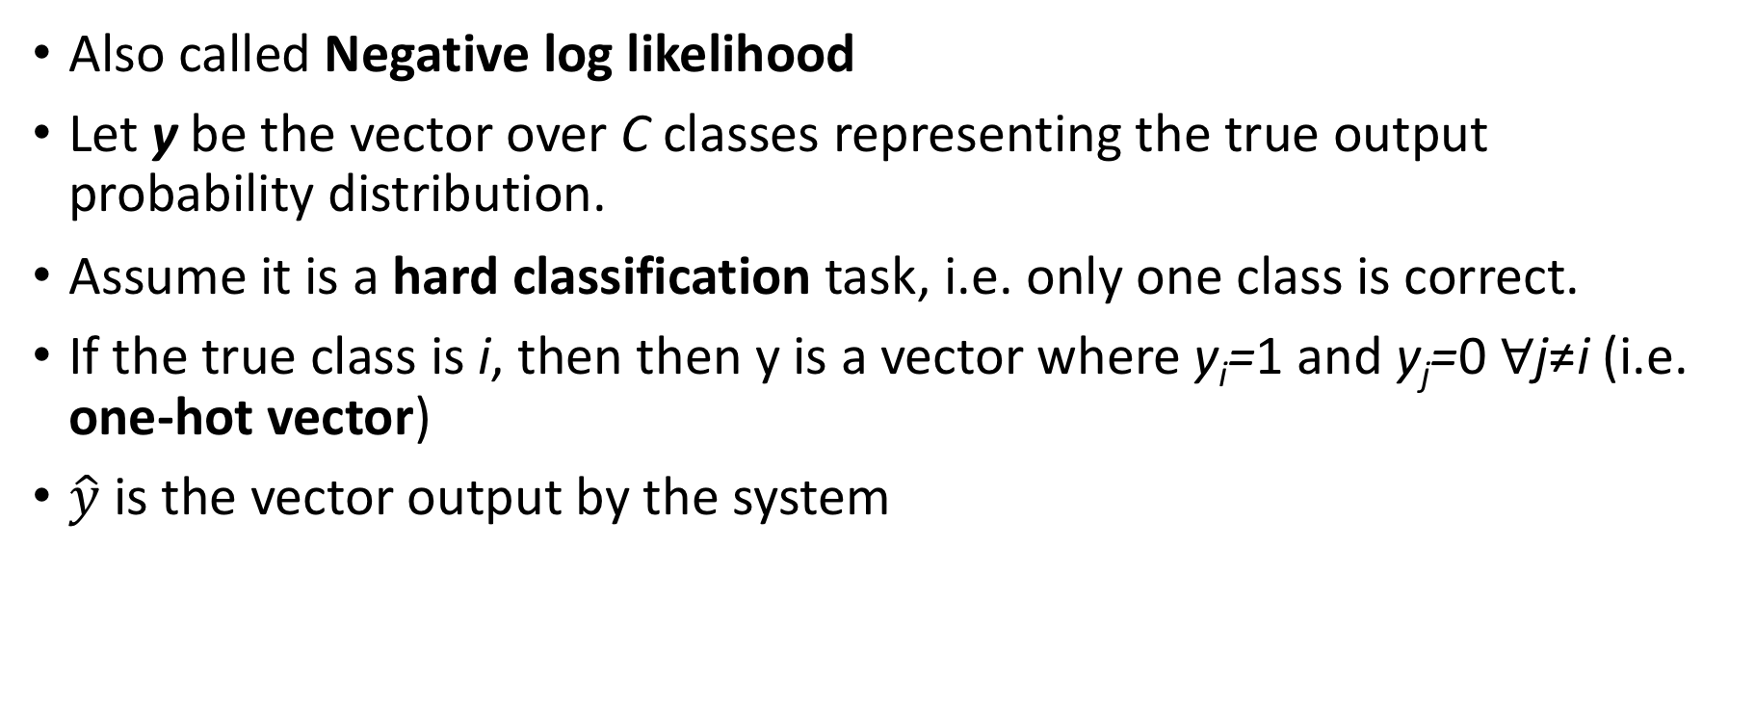
Cross entropy loss
Also called Negative log likelihood
Let y be the vector over C classes representing the true output probability distribution.
Assume it is a hard classification task, i.e. only one class is correct.
If the true class is i, then then y is a vector where y_{i}=1 and y_{j}=0 ∀j≠i (i.e. one-hot vector)
$\hat{y}$ is the vector output by the system

Slide 41
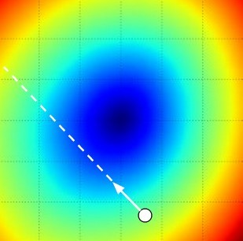


Following gradients
Gradient descent – a method that finds the minimum of a function by figuring out in which direction the function’s slope is rising most steeply, and moving in the opposite direction

Slide 42
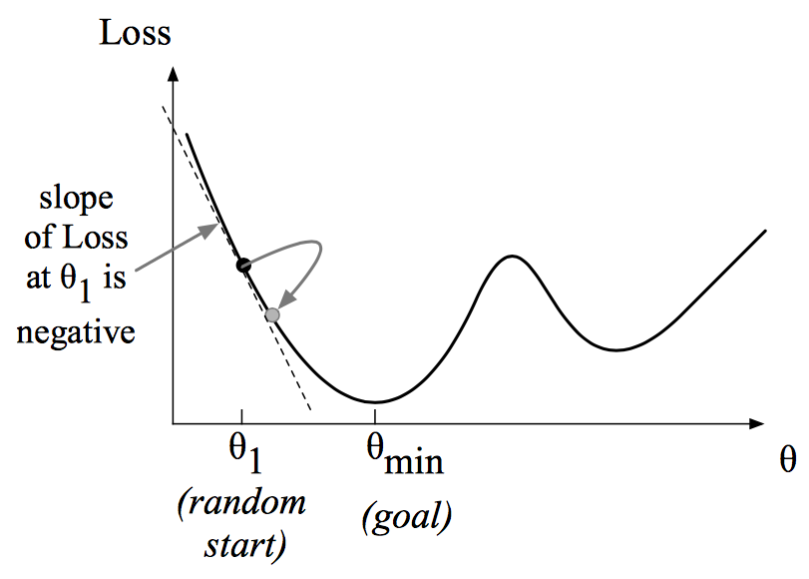
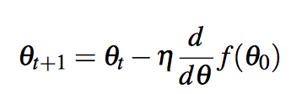
Gradient descent intuition
Find the gradient of the loss function at the current point and move in the opposite direction
The gradient of a function of many variables is a vector pointing in the direction of the greatest change in a function

Slide 43
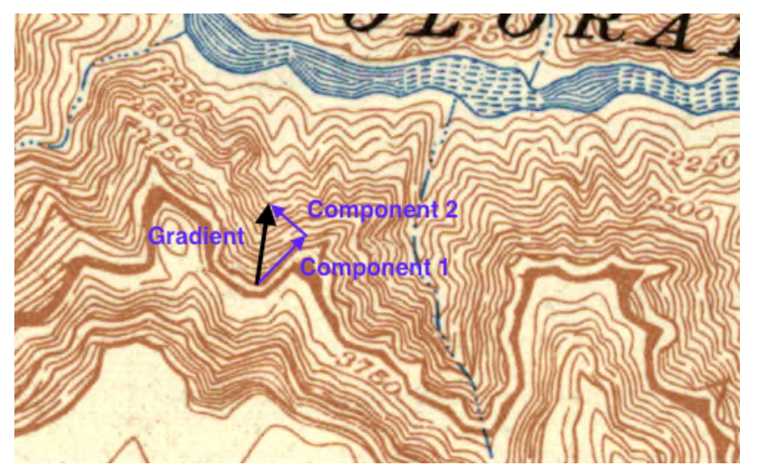
Gradient descent in N-dimensional space
The gradient is a vector expressing the directional components of the sharpest slope along each of the N dimensions

Slide 44
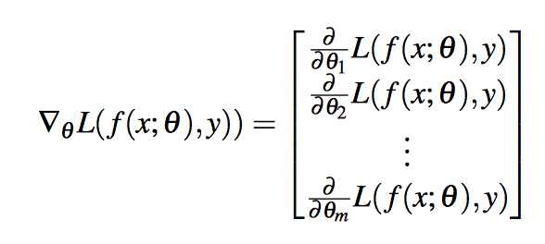


Gradients in a network with 𝜽 parameters
For each dimension 𝜽_{j} the gradient will have a component that tells us the slope w.r.t. that variable.
“How much would a small change in 𝜽_{j} influence the loss function L?”
The slope in each direction is expressed as partial derivative of the loss function. The gradient is the vector of these partials:
The final equation for updating 𝜽:
$$\frac{d}{{dθ}_{j}}$$

Slide 45
Computing the gradient
Error backpropagation or backprop
The loss function is modelled as a computation graph
  Each edge is a computation
  Each node is the result of the computation
Chain rule of differentiation is then used to annotate this graph with partial derivatives of the loss function along each edge of the graph.

Slide 46



Lecture 5 -
46
Fei-Fei Li & Andrej Karpathy Lecture 5 - 21 Jan 2015

Slide 47



Example: x = 4, y = -3.
=> f(x,y) = -12
partial derivatives
gradient
Lecture 5 -
47
Fei-Fei Li & Andrej Karpathy Lecture 5 - 21 Jan 2015

Slide 48
Example: x = 4, y = -3.
=> f(x,y) = -12
partial derivatives gradient
Question: If I increase x by h, how would the output of f change?
Lecture 5 -
48
Fei-Fei Li & Andrej Karpathy Lecture 5 - 21 Jan 2015

Slide 49





Compound expressions:
Fei-Fei Li & Andrej Karpathy Lecture 5 - 21 Jan 2015

Slide 50

Compound expressions:
Chain rule:
Fei-Fei Li & Andrej Karpathy Lecture 5 - 21 Jan 2015

Slide 51
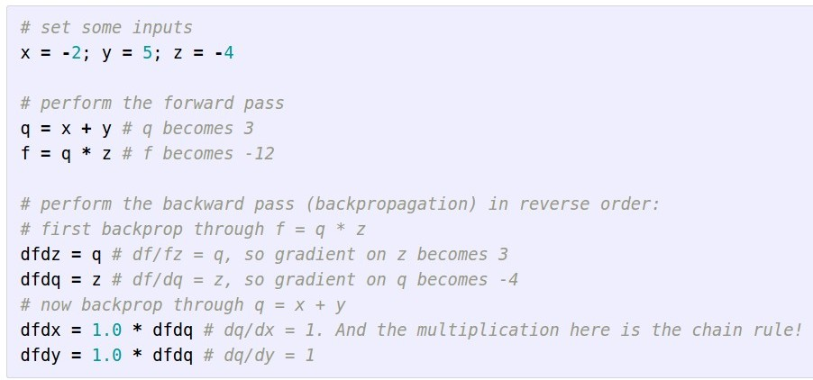
Compound expressions:
Chain rule:
Fei-Fei Li & Andrej Karpathy Lecture 5 - 21 Jan 2015

Slide 52
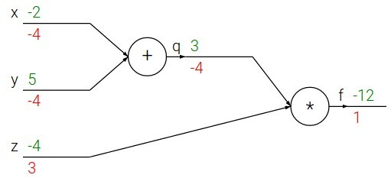
Compound expressions:
Chain rule:
Fei-Fei Li & Andrej Karpathy Lecture 5 - 21 Jan 2015

Slide 53
Practical considerations
Selecting hyperparameters
  Optimization algorithm
    Stochastic Gradient Descent (SGD)
    AdaDelta
    Adam (preferred)
  Minibatch size
  Learning rate 𝜂
  Learning rate decay rate

Slide 54

Neural Language Models
Advantages:
  Don’t need smoothing
  Can handle longer histories
  Can generalize over contexts of similar words
Costs:
  Slower to train
  Traditional LMs (e.g. LM with Kneser-Ney smoothing) are adequate for some tasks
Task: Predict the next word based on the N previous words:

Slide 55
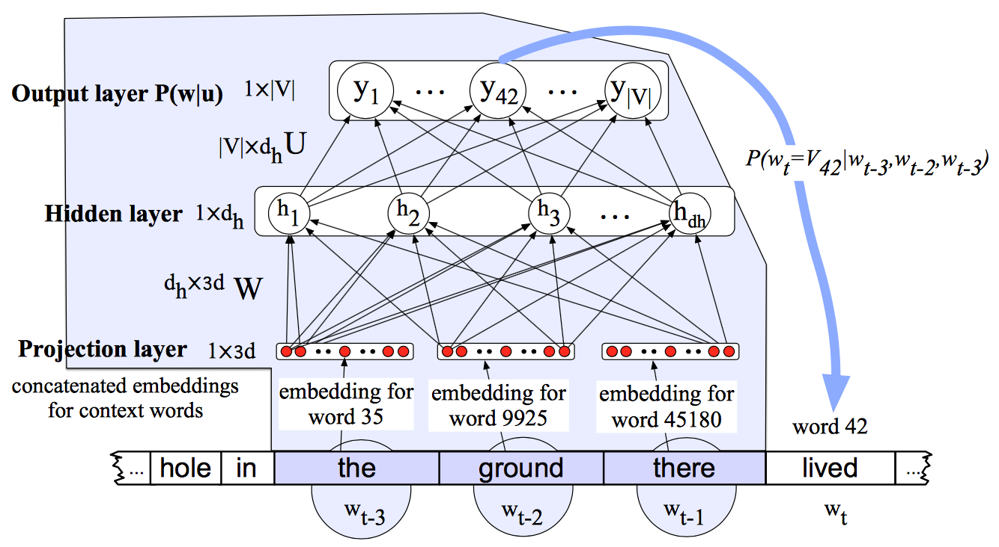
Feed-forward Neural Network Language Model with pre-trained word embeddings

Slide 56
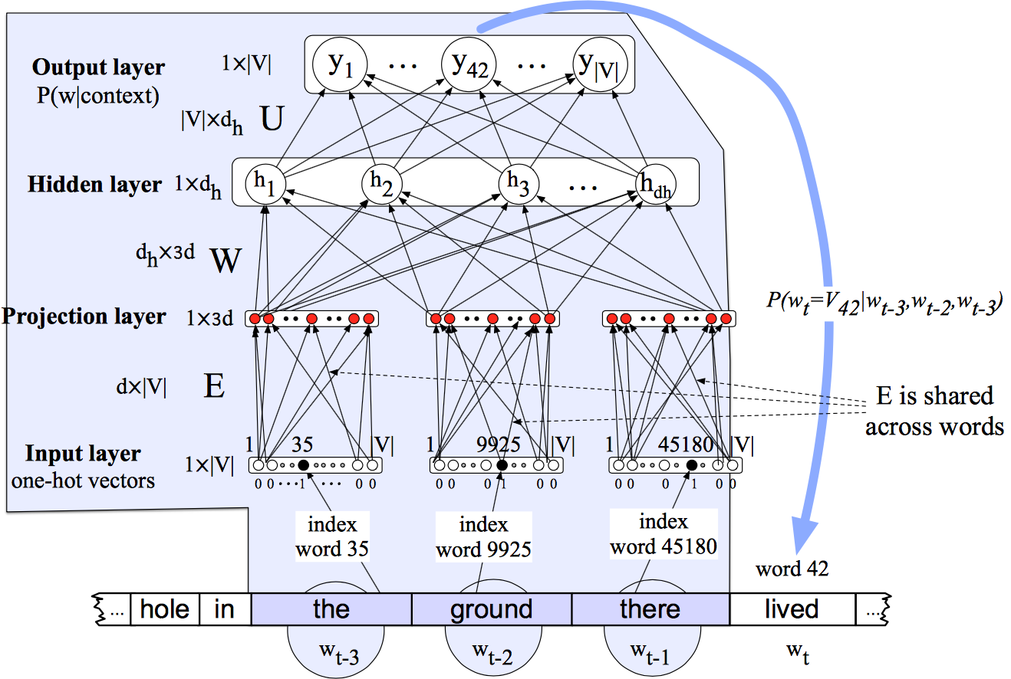
Feed-forward Neural Network Language Model with one-hot word vectors

Slide 57
Pre-training word embeddings with word2vec
Represent each word with a low-dimensional vector
Word similarity = vector similarity
Key idea: predict surrounding words of every word
Faster and can easily incorporate a new sentence/document or add a word to the vocabulary

Slide 58
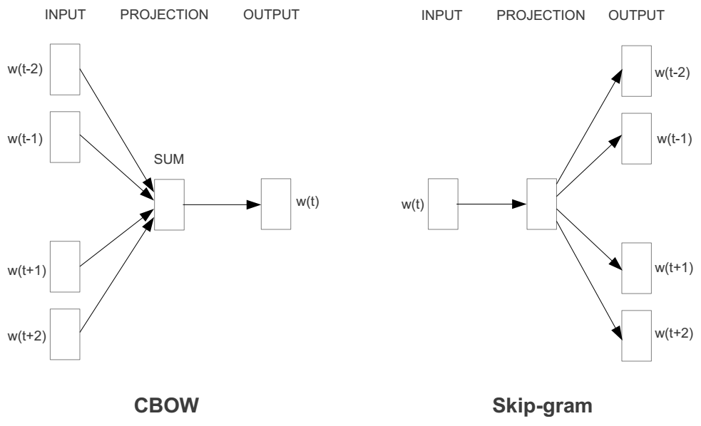
Word2vec models
Two basic neural network models:
  Continuous Bag of Word (CBOW): use a window of word to predict the middle word
  Skip-gram (SG): use a word to predict the surrounding ones in window.

Slide 59
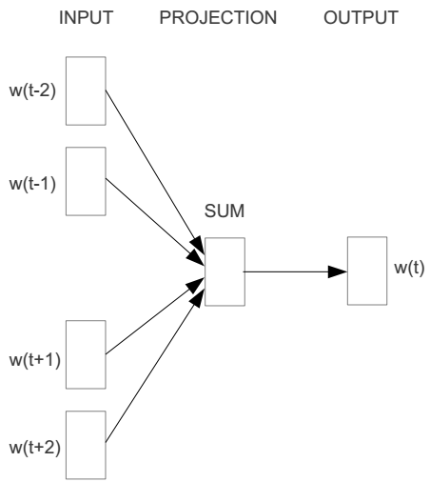
Word2vec – Continuous Bag of Words (CBOW)
E.g. “The cat sat on floor”
  Window size = 2
the
cat
sat
on
floor

Slide 60
Input layer
Index of cat in vocabulary
0
1
0
cat
0
Hidden layer
Output layer
0
0
0
0
0
0
…
0
0
0
one-hot
vector
0
sat
one-hot
vector
0
0
0
0
1
0
…
1
0
on
0
0
0
0
…
0

Slide 61



We must learn W and W’
Input layer
0
1
0
cat
0
$$W_{V×N}$$
Hidden layer
Output layer
0
0
0
0
0
0
V-dim
…
0
0
$${W′}_{V×N}$$
0
0
sat
0
0
0
0
1
0
$$W_{V×N}$$
N-dim
…
V-dim
1
0
on
0
0
0
0
V-dim
…
N will be the size of word vector
0

Slide 62
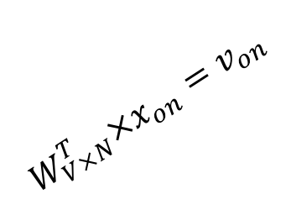

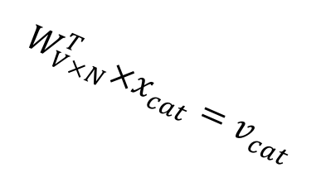



$$W_{V×N}^{T} ×x_{cat}=v_{cat}$$
0.1 | 2.4 | 1.6 | 1.8 | 0.5 | 0.9 | … | … | … | 3.2
0.5 | 2.6 | 1.4 | 2.9 | 1.5 | 3.6 | … | … | … | 6.1
… | … | … | … | … | … | … | … | … | …
… | … | … | … | … | … | … | … | … | …
0.6 | 1.8 | 2.7 | 1.9 | 2.4 | 2.0 | … | … | … | 1.2
0
2.4
2.6
…
…
1.8
Input layer
1
$$×$$
0
$$=$$
0
0
1
0
0
0
x_{cat}
0
0
Output layer
0
0
0
$$W_{V×N}^{T}×x_{cat}=v_{cat}$$
…
0
0
0
0
0
V-dim
…
0
0
$$\hat{v}=\frac{v_{cat}+v_{on}}{2}$$
0
+
0
sat
0
0
0
0
$$W_{V×N}^{T}×x_{on}=v_{on}$$
1
0
…
V-dim
1
Hidden layer
0
x_{on}
0
0
N-dim
0
0
V-dim
…
0

Slide 63

$$W_{V×N}^{T} ×x_{on}=v_{on}$$
0.1 | 2.4 | 1.6 | 1.8 | 0.5 | 0.9 | … | … | … | 3.2
0.5 | 2.6 | 1.4 | 2.9 | 1.5 | 3.6 | … | … | … | 6.1
… | … | … | … | … | … | … | … | … | …
… | … | … | … | … | … | … | … | … | …
0.6 | 1.8 | 2.7 | 1.9 | 2.4 | 2.0 | … | … | … | 1.2
0
1.8
2.9
…
…
1.9
Input layer
0
$$×$$
0
$$=$$
0
1
1
0
0
0
x_{cat}
0
0
Output layer
0
0
0
$$W_{V×N}^{T}×x_{cat}=v_{cat}$$
…
0
0
0
0
0
V-dim
…
0
0
$$\hat{v}=\frac{v_{cat}+v_{on}}{2}$$
0
+
0
sat
0
0
0
0
$$W_{V×N}^{T}×x_{on}=v_{on}$$
1
0
…
V-dim
1
Hidden layer
0
x_{on}
0
0
N-dim
0
0
V-dim
…
0

Slide 64






Input layer
0
1
0
cat
0
$$W_{V×N}$$
Hidden layer
Output layer
0
0
0
0
0
0
V-dim
…
0
0
$$W_{V×N}^{′}\hat{v}=z$$
0
$$\hat{y}=softmax(z)$$
0
0
0
0
0
$$\hat{v}$$
1
0
$$W_{V×N}$$
…
1
N-dim
0
on
0
${\hat{y}}_{sat}$
0
0
V-dim
0
V-dim
…
N will be the size of word vector
0

Slide 65




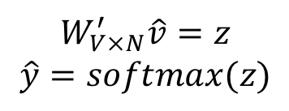
Input layer
0
We would prefer $\hat{y}$ close to ${\hat{y}}_{sat}$
1
0
cat
0
$$W_{V×N}$$
Hidden layer
Output layer
0
0
0
0
0.01
0.02
0.00
0.02
0.01
0.02
0.01
0.7
…
0.00
0
0
V-dim
…
0
0
$$W_{V×N}^{′}\hat{v}=z$$
$$\hat{y}=softmax(z)$$
0
0
0
0
0
0
$$\hat{v}$$
1
0
$$W_{V×N}$$
…
1
N-dim
0
on
0
${\hat{y}}_{sat}$
0
0
V-dim
0
V-dim
…
N will be the size of word vector
$\hat{y}$
0

Slide 66




$$W_{V×N}^{T}$$
0.1 | 2.4 | 1.6 | 1.8 | 0.5 | 0.9 | … | … | … | 3.2
0.5 | 2.6 | 1.4 | 2.9 | 1.5 | 3.6 | … | … | … | 6.1
… | … | … | … | … | … | … | … | … | …
… | … | … | … | … | … | … | … | … | …
0.6 | 1.8 | 2.7 | 1.9 | 2.4 | 2.0 | … | … | … | 1.2
Contain word’s vectors
Input layer
0
1
0
x_{cat}
0
Output layer
0
0
$$W_{V×N}^{}$$
0
0
0
0
V-dim
…
0
0
$$W_{V×N}^{′}$$
0
0
sat
0
0
0
0
1
0
$$W_{V×N}^{}$$
…
1
0
V-dim
x_{on}
0
Hidden layer
0
N-dim
0
0
V-dim
…
0
We can consider either W or W’ as the word’s representation. Or even take the average.
Notes:
W contains input word vectors.
W’ contains output word vectors.
We can consider either W or W’ as the word’s representation. Or even take the average.

Slide 67
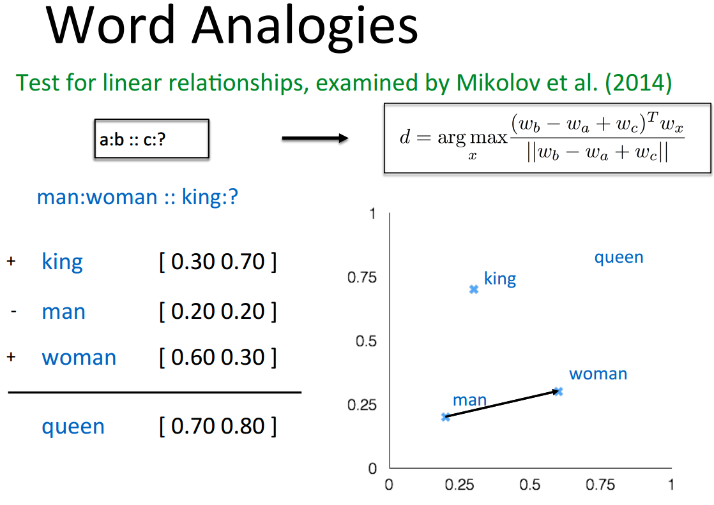
Some interesting results

Slide 68
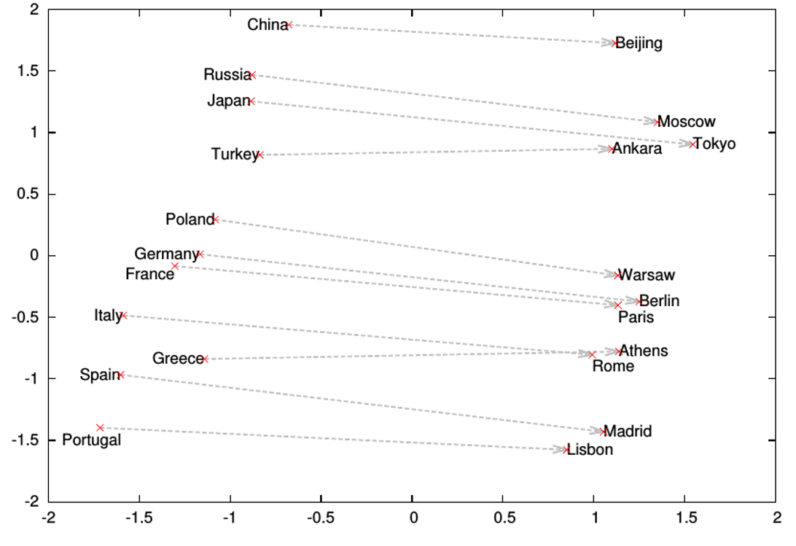
Word analogies

Slide 69
Credits
The word2vec slides have been adapted from the course by Vagelis Hristides: http://www.cs.ucr.edu/~vagelis/classes/CS242/index.htm
The neural network slides have been adapted from http://cs231n.github.io

