Slide 1
Word collocations

Slide 2
What is a Collocation?
A COLLOCATION is an expression consisting of two or more words that correspond to some conventional way of saying things.
The words together can mean more than their sum of parts (The Times of India, disk drive)
Previous examples: hot dog, mother in law
Examples of collocations
noun phrases like strong tea and weapons of mass destruction
phrasal verbs like to make up, and other phrases like the rich and powerful.
Valid or invalid?
a stiff breeze but not a stiff wind (while either a strong breeze or a strong wind is okay).
broad daylight (but not bright daylight or narrow darkness).

Slide 3
Criteria for Collocations
Typical criteria for collocations:
non-compositionality
non-substitutability
non-modifiability.
Collocations usually cannot be translated into other languages word by word.
A phrase can be a collocation even if it is not consecutive (as in the example knock . . . door).

Slide 4
Non-Compositionality
A phrase is compositional if the meaning can be predicted from the meaning of the parts.
E.g. new companies
A phrase is non-compositional if the meaning cannot be predicted from the meaning of the parts
E.g. hot dog
Collocations are not necessarily fully compositional in that there is usually an element of meaning added to the combination. Eg. strong tea.
Idioms are the most extreme examples of non-compositionality. Eg. to hear it through the grapevine.

Slide 5
Non-Substitutability
We cannot substitute near-synonyms for the components of a collocation.
For example
We can’t say yellow wine instead of white wine even though yellow is as good a description of the color of white wine as white is (it is kind of a yellowish white).
Many collocations cannot be freely modified with additional lexical material or through grammatical transformations (Non-modifiability).
E.g. white wine, but not whiter wine
mother in law, but not mother in laws

Slide 6
Linguistic Subclasses of Collocations
Light verbs:
Verbs with little semantic content like make, take and do.
E.g. make lunch, take easy,
Verb particle constructions
E.g. to go down
Proper nouns
E.g. Bill Clinton
Terminological expressions refer to concepts and objects in technical domains.
E.g. Hydraulic oil filter

Slide 7
Principal Approaches to Finding Collocations
How to automatically identify collocations in text?
Simplest method: Selection of collocations by frequency
Selection based on mean and variance of the distance between focal word and collocating word
Hypothesis testing
Mutual information

Slide 8
Frequency
Find collocations by counting the number of occurrences.
Need also to define a maximum size window
Usually results in a lot of function word pairs that need to be filtered out.
Fix: pass the candidate phrases through a part of-speech filter which only lets through those patterns that are likely to be “phrases”. (Justesen and Katz, 1995)

Slide 9
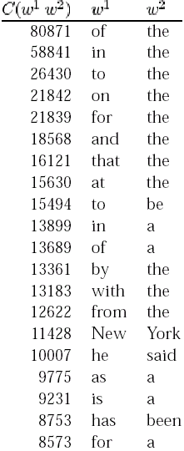
Most frequent bigrams in an
Example Corpus
Except for New York, all the bigrams are pairs of function words.

Slide 10
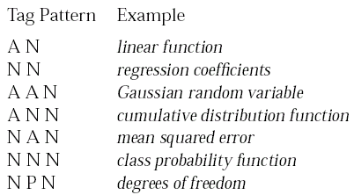
Part of speech tag patterns for collocation filtering
(Justesen and Katz).

Slide 11
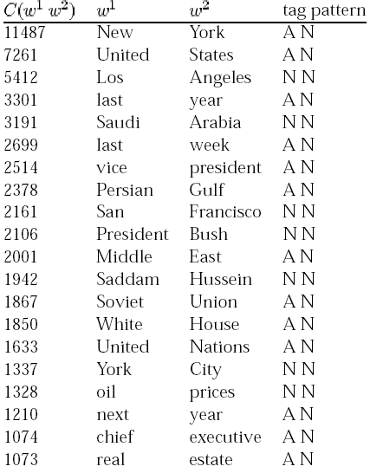
The most highly ranked
phrases after applying the filter on the same corpus as before.

Slide 12
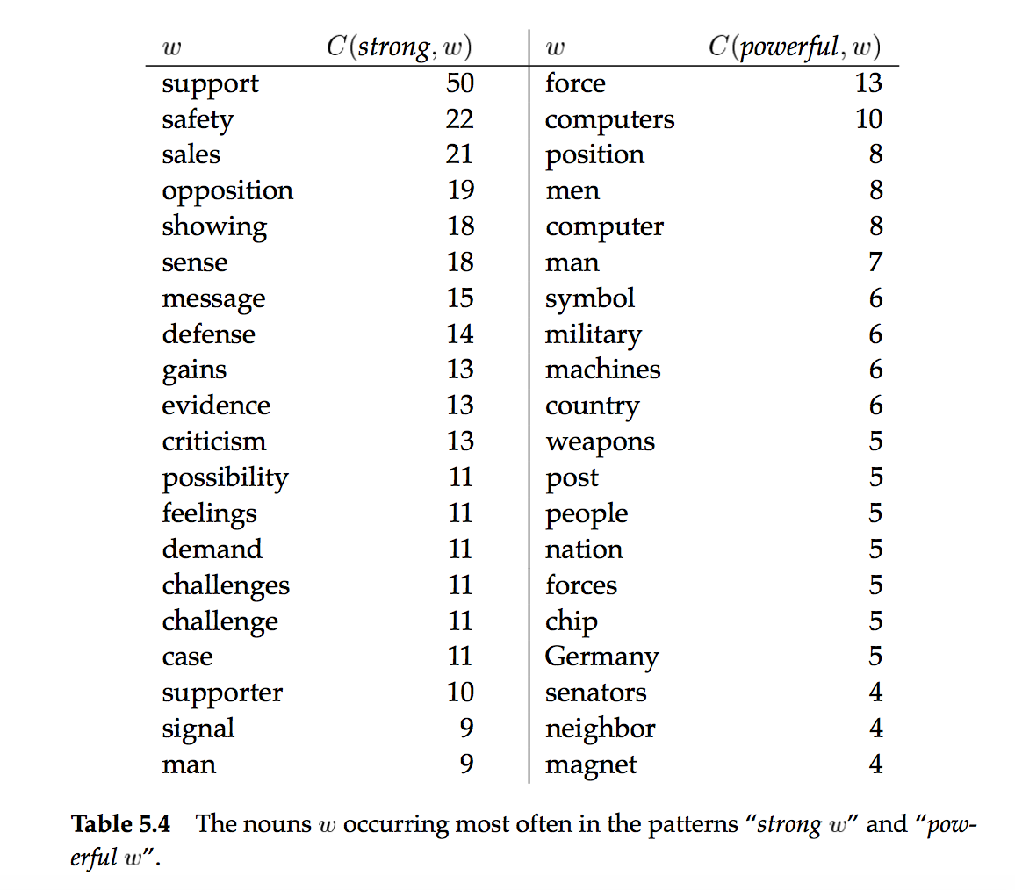

Slide 13
Collocational Window
Many collocations occur at variable distances. A collocational window needs to be defined to locate these. Frequency based approach can’t be used.
she knocked on his door
they knocked at the door
100 women knocked on Jack Donaldson’s door
a man knocked on the metal front door

Slide 15
Mean and Variance
The mean μ is the average offset between two words in the corpus.
The variance:
where n is the number of times the two words co-occur, d_{i} is the offset for co-occurrence i, and μ is the mean.
Mean and variance characterize the distribution of distances between two words in a corpus.
High variance means that co-occurrence is mostly by chance
Low variance means that the two words usually occur at about the same distance.

Slide 16
Mean and Variance: An Example
For the knock, door example sentences the mean is:
And the sample deviation:

Slide 18
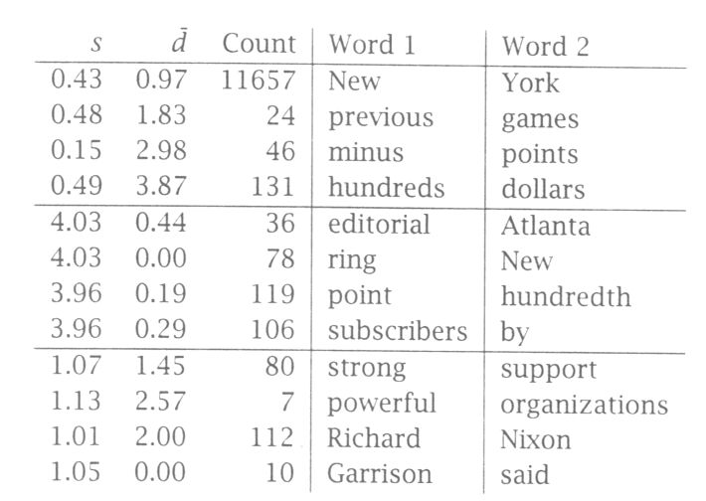
Finding collocations based on mean and variance

Slide 19
Ruling out Chance
Two words can co-occur by chance.
High frequency and low variance can be accidental
Hypothesis Testing measures the confidence that this co-occurrence was really due to association, and not just due to chance.
Formulate a null hypothesis H₀ that there is no association between the words beyond chance occurrences.
The null hypothesis states what should be true if two words do not form a collocation.
If the null hypothesis can be rejected, then the two words do not co-occur by chance, and they form a collocation
Compute the probability p that the event would occur if H₀ were true, and then reject H₀ if p is too low (typically if beneath a significance level of p < 0.05, 0.01, 0.005, or 0.001) and retain H₀ as possible otherwise.

Slide 20
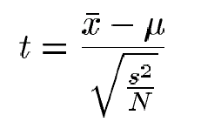
The t-Test
t-test looks at the mean and variance of a sample of measurements, where the null hypothesis is that the sample is drawn from a distribution with mean μ.
The test looks at the difference between the observed and expected means, scaled by the variance of the data, and tells us how likely one is to get a sample of that mean and variance, assuming that the sample is drawn from a normal distribution with mean μ.
Where x is the sample mean, s² is the sample variance, N is the sample size, and μ is the mean of the distribution.

Slide 21
t-Test for finding collocations
Think of the text corpus as a long sequence of N bigrams, and the samples are then indicator random variables with:
value 1 when the bigram of interest occurs,
0 otherwise.
The t-test and other statistical tests are useful as methods for ranking collocations.
Step 1: Determine the expected mean
Step 2: Measure the observed mean
Step 3: Run the t-test

Slide 22
t-Test: Example
In our corpus, new occurs 15,828 times, companies 4,675 times, and there are 14,307,668 tokens overall.
new companies occurs 8 times among the 14,307,668 bigrams
H₀ : P(new companies) =P(new)P(companies)

Slide 23
t-Test example
For this distribution μ= 3.615 x 10⁻⁷ and σ² = p(1-p) =~ p
t value of 0.999932 is not larger than 2.576, the critical value for a=0.005. So we cannot reject the null hypothesis that new and companies occur independently and do not form a collocation.

Slide 24
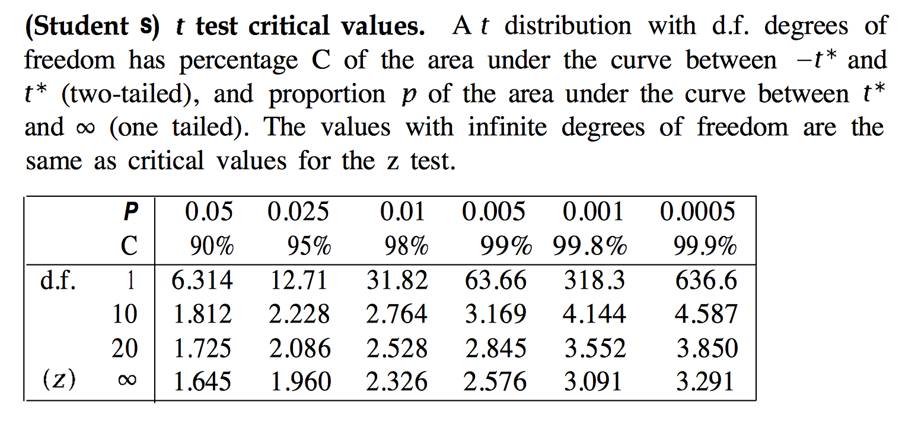

Slide 26
Hypothesis testing of differences (Church and Hanks, 1989)
To find words whose co-occurrence patterns best distinguish between two words.
For example, in computational lexicography we may want to find the words that best differentiate the meanings of strong and powerful.
The t-test is extended to the comparison of the means of two normal populations.
Here the null hypothesis is that the average difference is 0 (μ =0).
In the denominator we add the variances of the two populations since the variance of the difference of two random variables is the sum of their individual variances.

Slide 27
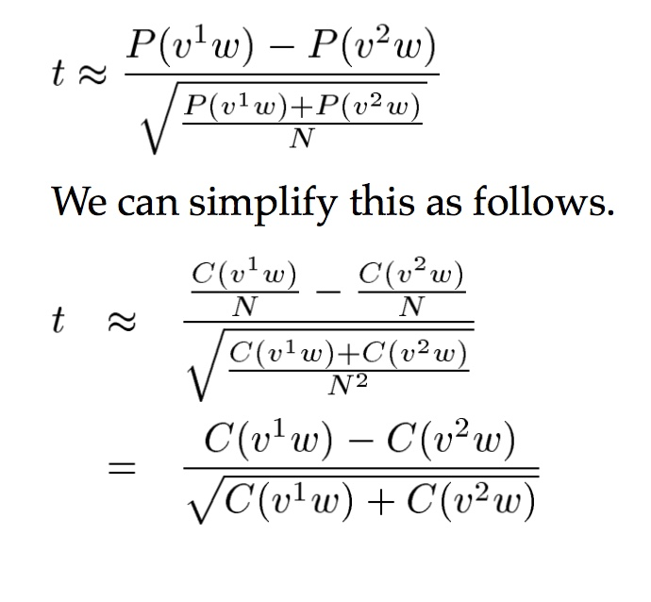
If w is the collocate of interest (e.g., computers or symbol) and v¹ and v² are the words we are comparing (e.g., powerful and strong), then:

Slide 29
Pearson’s chi-square test
t-test assumes that probabilities are approximately normally distributed, which is not true in general. The χ² test doesn’t make this assumption.
the essence of the χ ² test is to compare the observed frequencies with the frequencies expected for independence
if the difference between observed and expected frequencies is large, then we can reject the null hypothesis of independence.
Relies on co-occurrence table, and computes

Slide 31
χ² Test: Example
The χ² statistic sums the differences between observed and expected values in all squares of the table, scaled by the magnitude of the expected values, as follows:
where i ranges over rows of the table, j ranges over columns, O_{ij} is the
observed value for cell (i, j) and E_{ij} is the expected value.

Slide 32
χ² Test: Example
Observed values O are given in the table
E.g. O(1,1) = 8
Expected values E are determined from marginal probabilities:
E.g. E value for cell (1,1) = new companies is expected frequency for this bigram, determined by multiplying:
probability of new on first position of a bigram
probability of companies on second position of a bigram
total number of bigrams
E(1,1) = (8+15820)/N * (8+4667)/N * N =~ 5.2
χ² is then determined as 1.55:
Look up significance table:
χ² = 3.8 for probability level of α = 0.05
1.55 < 3.8
we cannot reject null hypothesis → new companies is not a collocation

Slide 33
χ² Test: Applications
Identification of translation pairs in aligned corpora (Church and Gale, 1991).
Determine chi-square for translation pairs
cow !cow
vache 59 6
!vache 8 570934
Corpus similarity (Kilgarriff and Rose, 1998)

Slide 34
Likelihood Ratios
It is simply a number that tells us how much more likely one hypothesis is than the other.
More appropriate for sparse data than the χ² test.
A likelihood ratio, is more interpretable than the χ² or t statistic.
For collocation discovery, we examine the following two alternative explanations for the occurrence frequency of a bigram w¹w²:
Hypothesis 1: The occurrence of w² is independent of the previous occurrence of w¹.
Hypothesis 2: The occurrence of w² is dependent on the previous occurrence of w¹.
The log likelihood ratio is then:

Slide 35
Likelihood ratios
Likelihood of getting the counts that we actually observed, using a binomial distribution:
H₁
H₂

Slide 36
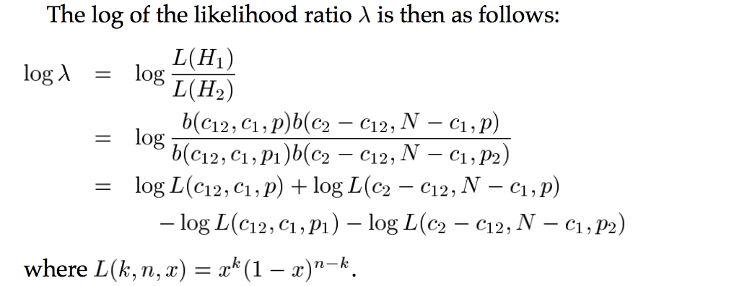
Likelihood ratios (cont.)

Slide 37
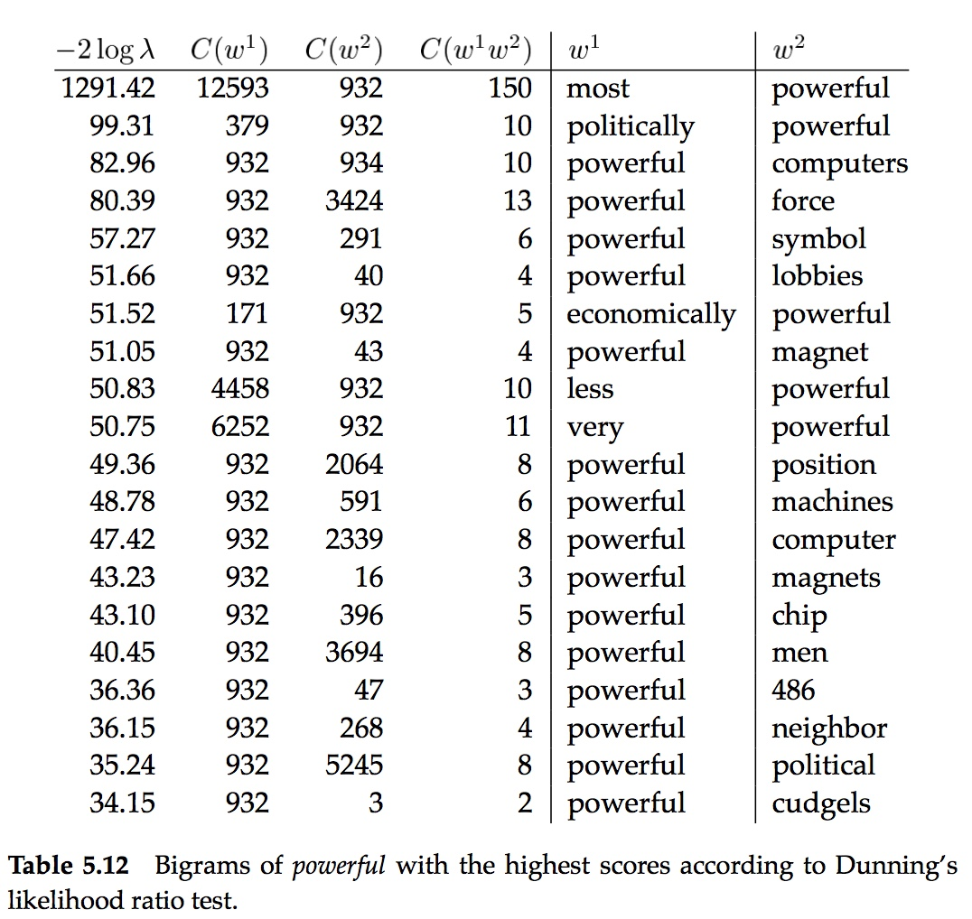

Slide 38
Relative Frequency Ratios (Damerau, 1993)
ratios of relative frequencies between two or more different corpora can be used to discover collocations that are characteristic of a corpus when compared to other corpora.
useful for the discovery of subject-specific collocations. The application proposed by Damerau is to compare a general text with a subject-specific text. Those words and phrases that on a relative basis occur most often in the subject-specific text are likely to be part of the vocabulary that is specific to the domain

Slide 39
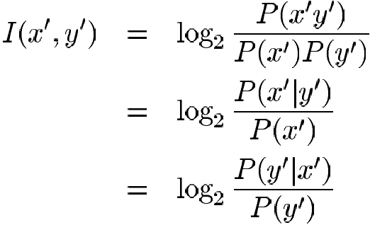
Pointwise Mutual Information
An information-theoretically motivated measure for discovering interesting collocations is pointwise mutual information (Church et al. 1989, 1991; Hindle 1990).
It is roughly a measure of how much one word tells us about the other.

Slide 41
Problems with using Mutual Information
Decrease in uncertainty is not always a good measure of an interesting correspondence between two events.
It is a bad measure of dependence.
Particularly bad with sparse data.

Slide 42
Normalized Pointwise Mutual Information (Bouma, 2009)

Slide 43
Credits
This slide set has been adapted from the NLP course of Paul Tarau (based on Rada Mihalcea’s original slides):
http://www.cse.unt.edu/~tarau/teaching/NLP/

