Slide 1
Pre-training and transfer learning

Slide 2
Real-life challenges in NLP tasks
Deep learning methods are data-hungry
>50K data items needed for training
The distributions of the source and target data must be the same
Labeled data in the target domain may be limited
This problem is typically addressed with transfer learning

Slide 3
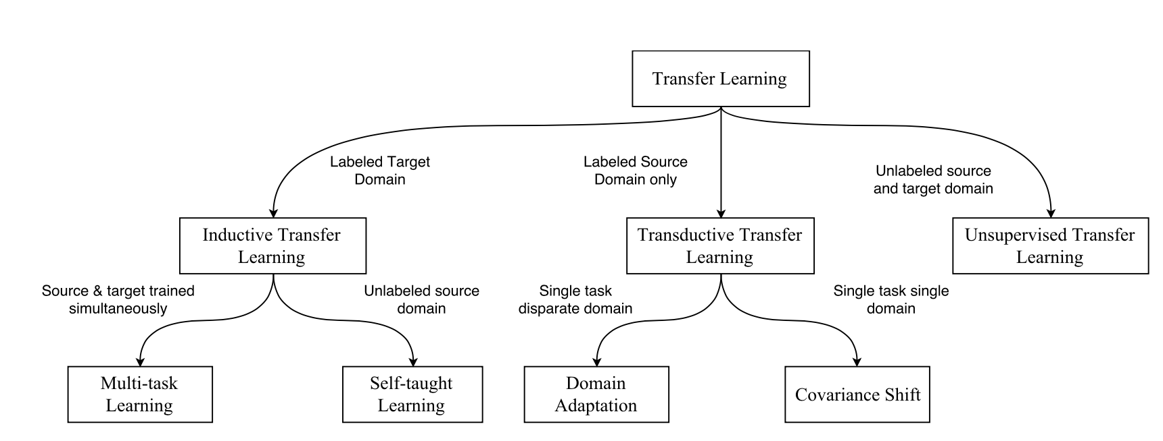
Transfer Learning Approaches
Source: https://arxiv.org/pdf/1802.05934.pdf

Slide 4
Transductive vs Inductive Transfer Learning
Transductive transfer
No labeled target domain data available
Focus of most transfer research in NLP
E.g. Domain adaptation
Inductive transfer
Labeled target domain data available
Goal: improve performance on the target task by training on other task(s)
Jointly training on >1 task (multi-task learning)
Pre-training (e.g. word embeddings)

Slide 5
Pre-training – Word Embeddings
Pre-trained word embeddings have been an essential component of most deep learning models
Problems with pre-trained word embeddings:
Shallow approaches – trade expressivity for efficiency
Learned word representations are not context sensitive
No distinction between senses
Only the first layer (embedding layer) of the model is pre-trained
The rest of the model must be trained from scratch

Slide 6
Recent paradigm shift in pre-training for NLP
Inspired by the success of models pre-trained on ImageNet in Computer Vision (CV)
The use of models pre-trained on ImageNet is now standard in CV

Slide 7
Recent paradigm shift in pre-training for NLP
What is a good equivalent of an ImageNet task in NLP?
Key desiderata:
An ImageNet-like dataset should be sufficiently large, i.e. on the order of millions of training examples.
It should be representative of the problem space of the discipline.
Contenders to that role:
Reading Comprehension (SQuaD dataset, 100K Q-A pairs)
Natural Language Inference (SNLI corpus, 570K sentence pairs)
Machine Translation (WMT 2014, 40M French-English sentence pairs)
Constituency parsing (millions of weakly labeled parses)
Language Modeling (unlimited data, current benchmark dataset: 1B words http://www.statmt.org/lm-benchmark/)
Source: https://thegradient.pub/nlp-imagenet/

Slide 8
The case for Language Modeling
LM captures many aspects of language:
Long-term dependencies
Hierarchical relations
Sentiment
Etc.
Training data is unlimited

Slide 9
LM as pre-training – Approaches
Embeddings from Language Models (ELMo) (Peters et al., 2018)
Universal Language Model Fine-tuning (ULMFiT) (Howard and Ruder, 2018)
OpenAI Transformer (Radford et al., 2018)
Overview of the above approaches: https://thegradient.pub/nlp-imagenet/

Slide 10
Universal Language Model Fine Tuning for Text Classification
Jeremy Howard and Sebastian Ruder
In Proc. ACL, 2018
Paper: https://arxiv.org/pdf/1801.06146.pdf
Code: http://nlp.fast.ai/category/classification.html

Slide 11
Approach
Inductive transfer setting:
Given a static source task and any target task with we would like to improve the performance on
Pre-train a language model (LM) on a large general-domain corpus
Fine-tune it on the target task using novel techniques
The method is universal
Works across tasks varying in document size, number and label type
Uses single architecture and training process
Requires no custom feature engineering or pre-processing
Does not require additional in-domain documents or labels

Slide 12
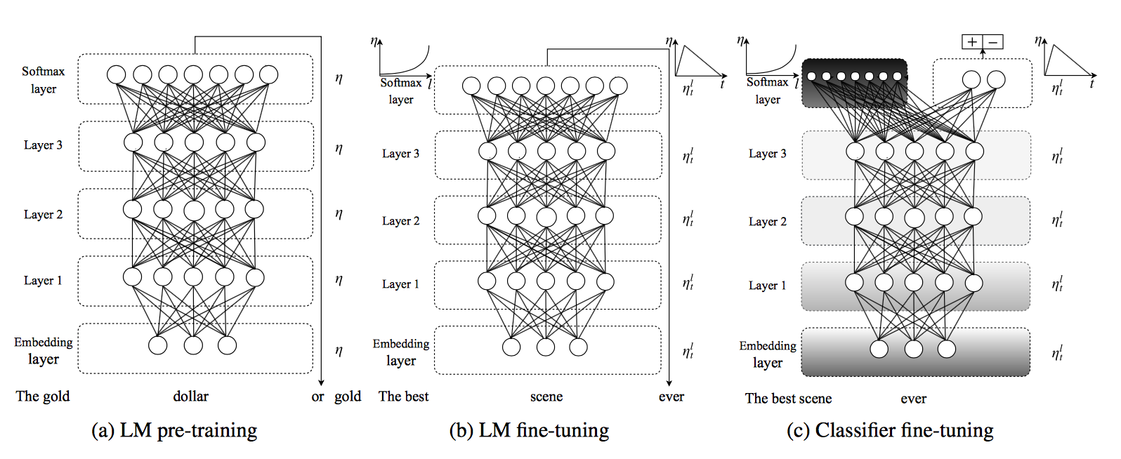
Steps

Slide 13
Step 1: General domain LM pre-training

Slide 14
General domain LM pre-training
Used AvSGD Weight-Dropped LSTM (AWD-LSTM, Merity et al. 2017)
LM pre-trained on Wikitext-103 (103M words)
Expensive, but performed only once
Improves performance and convergence of downstream tasks
Notes:
“Pretraining is most beneficial for tasks with small datasets and enables generalization even with 100 labeled examples.”

Slide 15
Step 2: Target task LM pre-training

Slide 16
Target task LM fine-tuning
Data for the target task is likely from a different distribution
Fine-tune the LM on data of the target task
This stage converges faster
Allows to train a robust LM even on small datasets
Two approaches to fine-tuning:
Discriminative fine-tuning
Slanted triangular learning rates

Slide 17
Discriminative fine-tuning
Different layers capture different types of information, hence, they should be fine-tuned to different extents
Instead of using one learning rate for all layers, tune each layer with different learning rates.
Regular SGD:
where is the learning rate and is the gradient with regard to the model’s objective function

Slide 18
Discriminative fine-tuning (cont.)
Discriminative fine-tuning:
Split parameters into where contains the parameters of the model at the 𝑙-th layer and 𝑳 is the number of layers of the model
Obtain where is the learning rate of the 𝑙-th layer
SGD update with discriminative fine-tuning:
Fine tune the last layer and use as the learning rate for lower layers

Slide 19
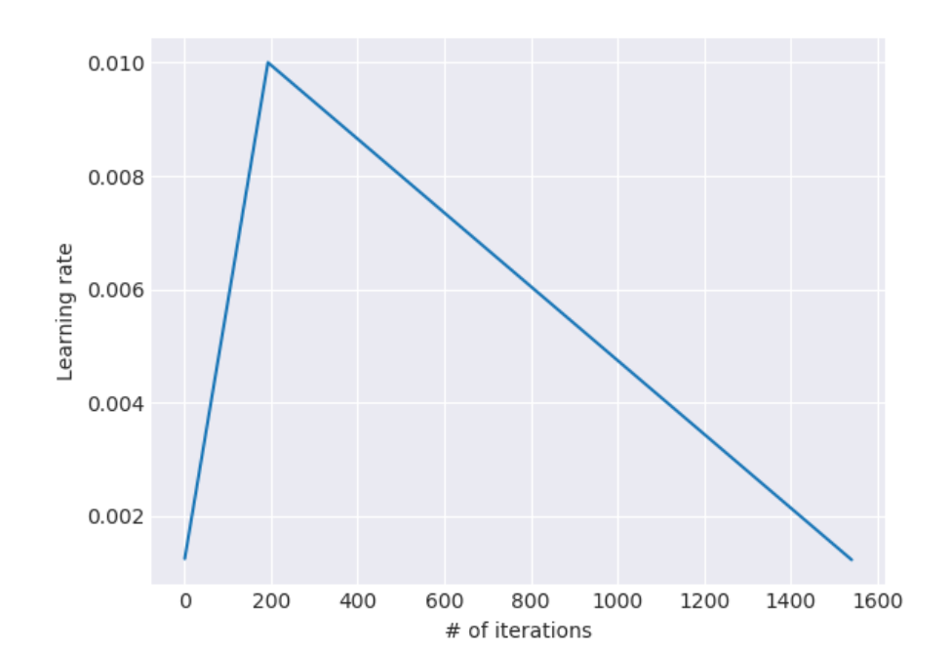
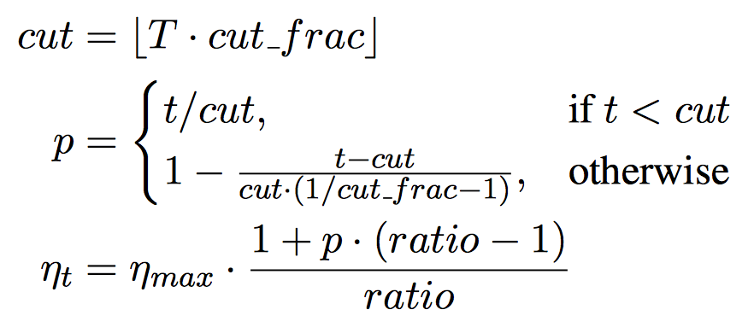
Slanted triangular learning rates (STLR)
Intuition for adapting parameters to task-specific features:
At the beginning of training: quickly converge to a suitable region of the parameter space
Later during training: refine the parameters
Notes:
T is the number of training iterations
cut_frac is the fraction of iterations we increase the LR
cut is the iteration when we switch from increasing to decreasing the LR
p is the fraction of the number of iterations we have increased or will decrease the LR respectively
ratio specifies how much smaller the lowest LR is from the maximum LR η_{max}
η_{t} tis the learning rate at iteration t.

Slide 20
Step 3: Target task classifier fine-tuning

Slide 21
Target task classifier fine-tuning
Augment the pre-trained language model with two additional linear layers:
ReLU activations in the intermediate layer
Softmax as the last layer
These are the only layers, whose parameters are learned from scratch
First layer takes as input the pooled last hidden layer states

Slide 22
Concat pooling
Input sequences may consist of hundreds of words → information may get lost if we only use the last hidden state of the model
Concatenate the hidden state at the last time step h_{T} of the document with:
Max-pooled representation of the hidden states
Mean-pooled representation of the hidden states
over as many time steps as fit in GPU memory H = {h₁, ..., h_{T}}:
where [] is concatenation

Slide 23
Fine-tuning Procedure – Gradual Unfreezing
Overly aggressive fine-tuning causes catastrophic forgetting
Too cautious fine-tuning leads to slow convergence and overfitting
Proposed approach: gradual unfreezing
First unfreeze the last layer and fine-tune the unfrozen layer for one epoch
Then unfreeze the next lower frozen layer and fine-tune all unfrozen layers
Repeat until we fine-tune all layers until convergence in the last iteration
The combination of discriminative fine-tuning, slanted triangular learning rates and gradual unfreezing leads to best performance

Slide 24
Experiments

Slide 25
Tasks and Datasets
Sentiment analysis: binary (positive-negative) classification; the IMDb movie review dataset
Question classification: broad semantic categories; small TREC dataset
Topic classification: large-scale AG news and DBPedia ontology datasets

Slide 26
Results

Slide 27
Evaluation measure: error rate (lower is better)

Slide 28
Analysis
Low-shot learning – training a model for a task with small number of labeled samples

Slide 29
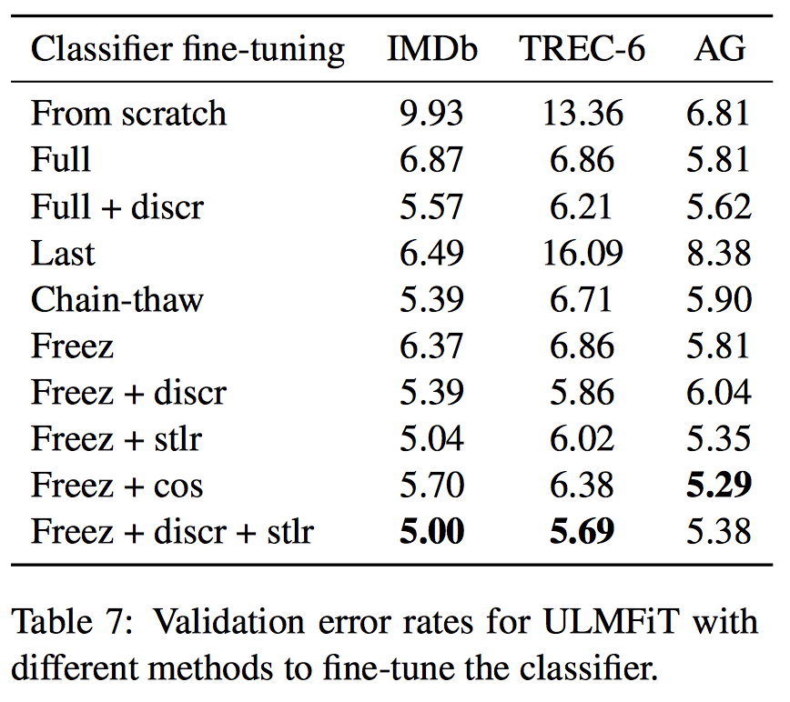
Different methods to fine-tune the classifier
Notes:
“Impact of classifier fine-tuning. We compare training from scratch, fine-tuning the full model (‘Full’), only fine-tuning the last layer (‘Last’) (Donahue et al.,2014), ‘Chain-thaw’ (Felbo et al.,2017), and gradual unfreezing (‘Freez’). We furthermore assess the importance of discriminative fine-tuning (‘Discr’) and slanted triangular learning rates (‘Stlr’). We compare the latter to an alternative, aggressive cosine annealing schedule (‘Cos’) (Loshchilov and Hutter,2017).”

Slide 30
“Full” vs ULMFiT

Slide 31
Conclusions
ULMFiT is useful for a variety of tasks (different datasets, sizes, domains)
Proposed approach to fine-tuning prevents catastrophic forgetting of knowledge learned during pre-training
Achieves good results even with 100 training data items
Generally LM pre-training and task-specific fine-tuning will be useful for scenarios where:
Training data is limited
New NLP tasks where no state-of-the-art architecture exists

Slide 32
Future work
Augment LM with additional tasks (i.e. multi-task learning setting)
Other tasks (entailment or QA) may require novel ways to pre-train and fine-tune
Need to understand better:
What knowledge a pre-trained model captures
How it changes during fine-tuning
What information different tasks require

