Slide 1
Disentangled Representation Learning for Non-Parallel Text Style Transfer
Vineet John, Lili Mou, Hareesh Bahuleyan and Olga Vechtomova
In Proc. ACL’19

Slide 2
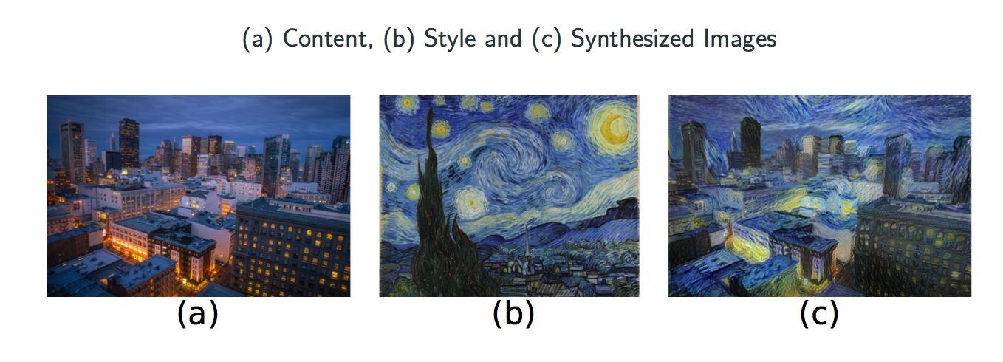
Visual style transfer

Slide 3
Key points of our approach
Transform an input sequence of Style A into a sequence of Style B
Experiments with style = sentiment (positive, negative)
No parallel corpus is used in this approach
Two model variants based on DAE and VAE
Learn two latent spaces: style and content
Use auxiliary objectives: (a) multi-task and (b) adversarial

Slide 4
Multi-Task Learning (MTL)
Machine learning approaches typically focus on one task, i.e. optimize one loss
Sharing representations between related tasks, the model can learn better on the original task.
MTL optimizes multiple losses

Slide 5
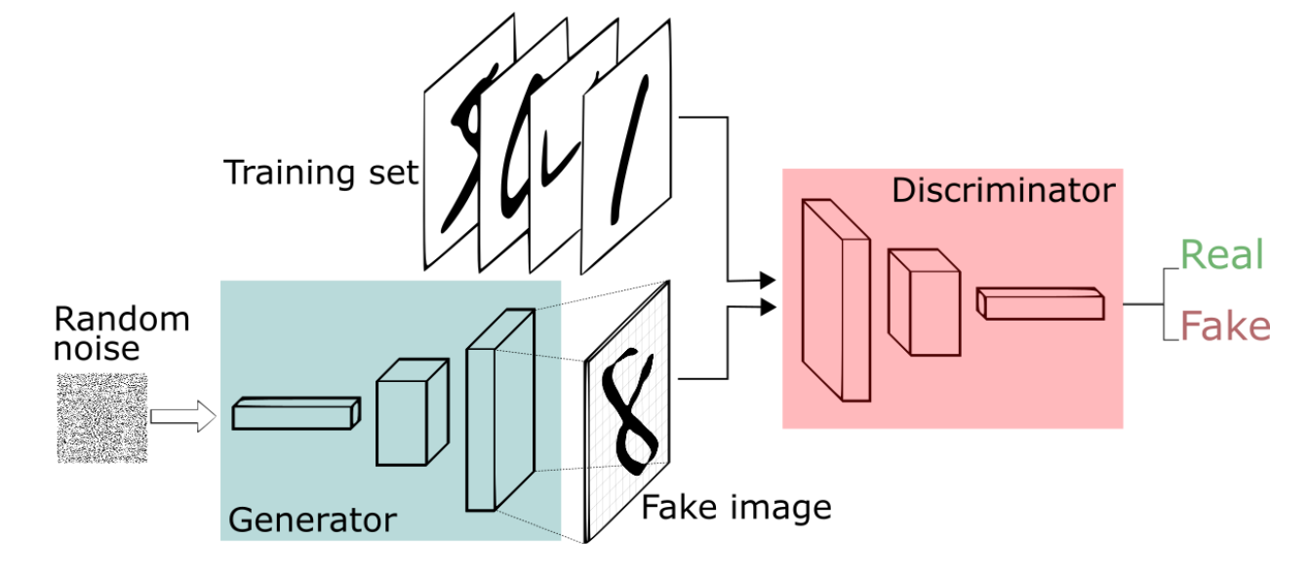
Adversarial learning (Goodfellow et al., 2014)

Slide 6
Model overview
Reconstruction objective: Sequence cross-entropy loss

Slide 7
Model overview
Content adversarial discriminator: Tries to predict content words from the “style” latent space. Encoder tries to “fool” it.

Slide 8
Model overview
Style multi-task discriminator: Tries to predict style from the “style” latent space.

Slide 9
Model overview
Style adversarial discriminator: Tries to predict style label from the “content” latent space. Encoder tries to “fool” it.

Slide 10
Model overview
Content multi-task discriminator: Tries to predict content words from the “content” latent space.

Slide 11
Visualization of the latent spaces

Slide 12
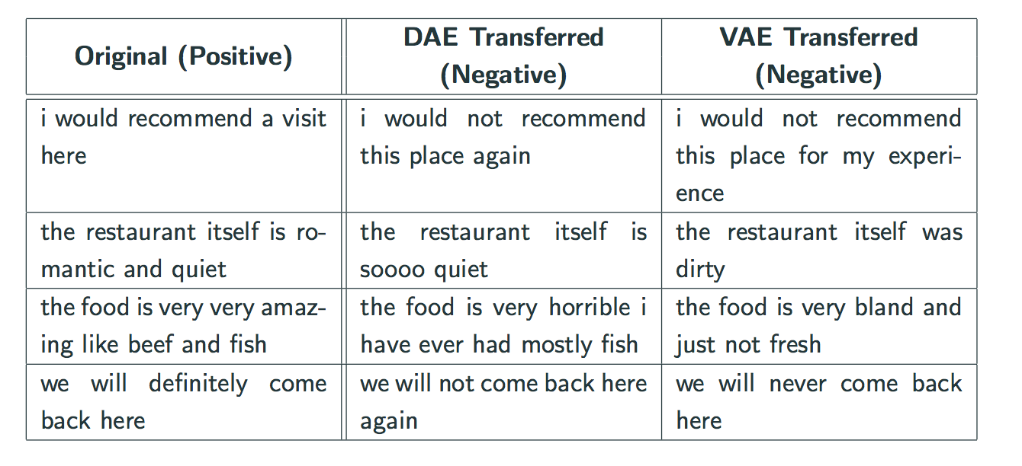
Examples (positive to negative)

Slide 13
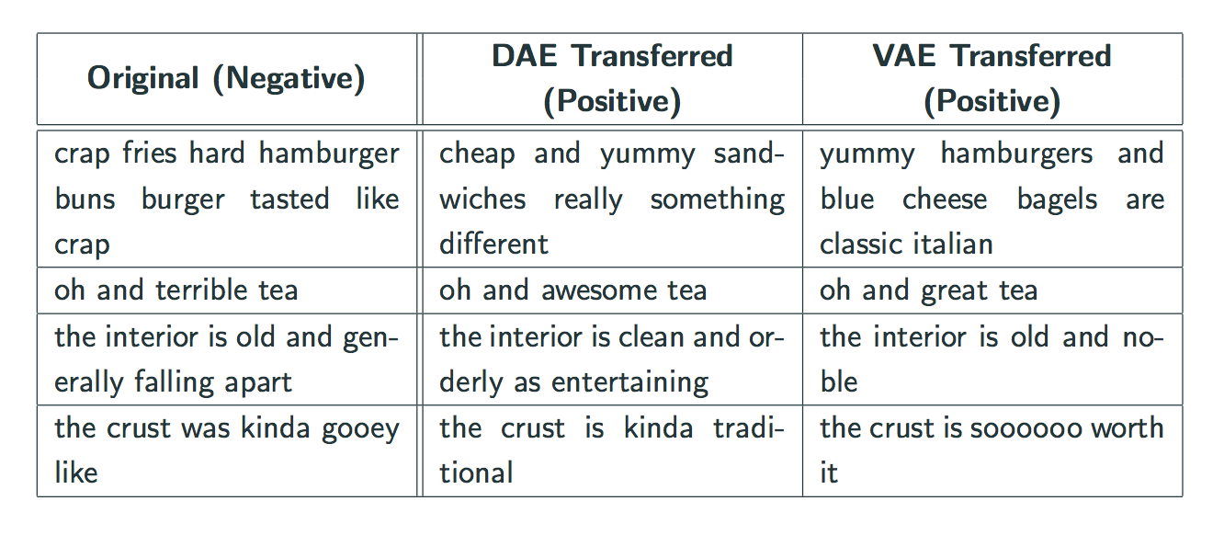
Examples (negative to positive)

Slide 14
Conclusions
Neural networks are powerful tools for various NLP tasks
Variational autoencoders and encoder-decoders can generate realistic natural language sentences
We demonstrated how it is possible to disentangle latent representation into style and content and applied it to text style transfer problem

Slide 15
Future work
Extend to multiple style labels, e.g. author’s style or genre
Disentangle other aspects of text, e.g.:
Syntactic structure
Semantics
Longer sequences, such as the entire text
Challenge: how to make style of the generated sentences consistent throughout text

Slide 16
References
Mikolov, Tomas, Kai Chen, Greg Corrado, and Jeffrey Dean. "Efficient estimation of word representations in vector space." arXiv preprint arXiv:1301.3781 (2013).
Goodfellow, Ian, Jean Pouget-Abadie, Mehdi Mirza, Bing Xu, David Warde-Farley, Sherjil Ozair, Aaron Courville, and Yoshua Bengio. "Generative adversarial nets." In Advances in neural information processing systems, pp. 2672-2680. 2014.
Kingma, Diederik P., and Max Welling. "Auto-encoding variational bayes." arXiv preprint arXiv:1312.6114 (2013).
Bahuleyan, Hareesh, Lili Mou, Olga Vechtomova, and Pascal Poupart. "Variational Attention for Sequence-to-Sequence Models." In COLING 2017.
John, Vineet, Lili Mou, Hareesh Bahuleyan, and Olga Vechtomova. "Disentangled Representation Learning for Text Style Transfer." In ACL 2019.

