Slide 1
Adversarial and multi-task learning for NLP

Slide 2
Generative Adversarial Networks (GANs)

Slide 3
Generative Adversarial Networks (GANs)
Goodfellow et al (2014) https://arxiv.org/abs/1406.2661
Minimize distance between the distributions of real data and generated samples
Discriminator tries to correctly distinguish real from fake data
Generator tries to fool discriminator

Slide 4
GAN intuition
Image source: https://www.analyticsvidhya.com/blog/2017/06/introductory-generative-adversarial-networks-gans/
Notes:
Pdata(x) ->the distribution of real data X -- sample from pdata(x) P(z) -- distribution of generator Z -- sample from p(z) G(z) -- Generator Network D(x) -- Discriminator Network

Slide 5
GAN formulation
Minimax game between the generator and discriminator
In practice, the generator is trained to maximize
Notes:
The minimax formulation minimizes the Jensen-Shannon divergence between the true data distribution and the generator’s output distribution.
“In our function V(D, G) the first term is entropy that the data from real distribution (pdata(x)) passes through the discriminator (aka best case scenario). The discriminator tries to maximize this to 1. The second term is entropy that the data from random input (p(z)) passes through the generator, which then generates a fake sample which is then passed through the discriminator to identify the fakeness (aka worst case scenario). In this term, discriminator tries to maximize it to 0 (i.e. the log probability that the data from generated is fake is equal to 0). So overall, the discriminator is trying to maximize our function V.
On the other hand, the task of generator is exactly opposite, i.e. it tries to minimize the function V so that the differentiation between real and fake data is bare minimum. This, in other words is a cat and mouse game between generator and discriminator!” (https://www.analyticsvidhya.com/blog/2017/06/introductory-generative-adversarial-networks-gans/)

Slide 6
Examples of the discriminator’s loss
Scenario 1: Discriminator winning:
D(X) = 0.9
D(G(Z)) = 0.1
V(D,G) = log(0.9) + log(1 – 0.1) = –0.211
Scenario 2: Generator winning:
D(X) = 0.5
D(G(Z)) = 0.5
V(D,G) = log(0.5) + log(1 – 0.5) = –1.386

Slide 7
GANs vs VAEs (image generation)
Image source: https://arxiv.org/pdf/1512.09300.pdf

Slide 8
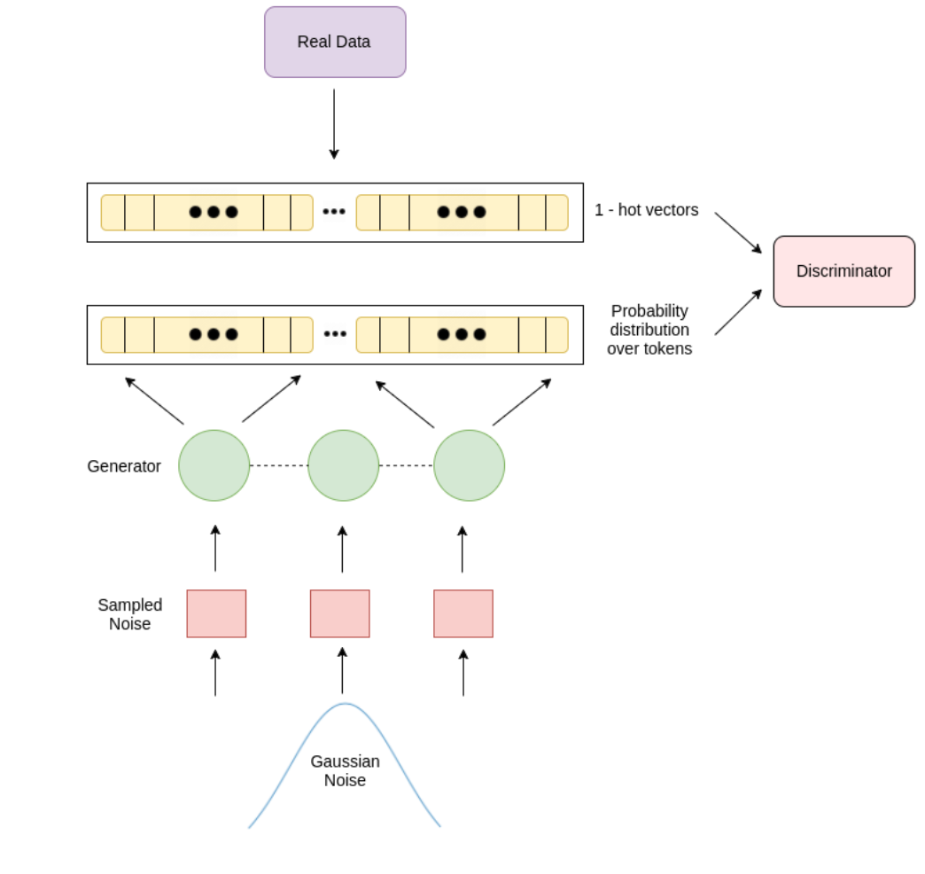
GANs for text generation
Problematic: GANs with the default formulation are not differentiable
Model by Rajeswar et al. 2017 https://arxiv.org/pdf/1705.10929.pdf
Image source: https://arxiv.org/pdf/1705.10929.pdf

Slide 9
Multi-Task Learning (http://ruder.io/multi-task/index.html)

Slide 10
Multi-Task Learning (MTL) – Intuition
Machine learning approaches typically focus on one task, i.e. optimize one loss
Sharing representations between related tasks, the model can learn better on the original task.
MTL optimizes multiple losses
Two approaches to MTL:
Hard parameter sharing
Soft parameter sharing

Slide 11
Hard parameter sharing
Most common approach
Share hidden layers between tasks
Task specific output layers
Reduces the risk of overfitting
The risk of overfitting the shared parameters is an order N (number of tasks) smaller than overfitting the task-specific parameters, i.e. the output layers
Source: http://ruder.io/multi-task/index.html

Slide 12
Soft parameter sharing
Each task has its own model with its own parameters
The distance between the parameters of the model is regularized in order to encourage the parameters to be similar (e.g. with L2 distance)
Source: http://ruder.io/multi-task/index.html

Slide 13
Why does MTL work?
MTL effectively increases the sample size that we are using for training our model.
All tasks are noisy. Our goal in training for task A is to learn a model that ignores data-specific noise and generalizes well.
Tasks have different noise patterns
A model that learns on two (or more) tasks is able to learn a more general representation
Source: http://ruder.io/multi-task/index.html
Notes:
“MTL effectively increases the sample size that we are using for training our model. As all tasks are at least somewhat noisy, when training a model on some task A, our aim is to learn a good representation for task A that ideally ignores the data-dependent noise and generalizes well. As different tasks have different noise patterns, a model that learns two tasks simultaneously is able to learn a more general representation. Learning just task A bears the risk of overfitting to task A, while learning A and B jointly enables the model to obtain a better representation F through averaging the noise patterns.” (S. Ruder, http://ruder.io/multi-task/index.html)

Slide 14
MTL examples

Slide 15
Cross-stitch networks (Misra et al., 2016)
Two separate models
“Cross-stitch” units learn a linear combination of the output of the previous layers of both networks
https://arxiv.org/pdf/1604.03539.pdf
Notes:
“They then use what they refer to as cross-stitch units to allow the model to determine in what way the task-specific networks leverage the knowledge of the other task by learning a linear combination of the output of the previous layers.” (S. Ruder, http://ruder.io/multi-task/index.html)
“We model shared representations by learning a linear combination of input activation maps. At each layer of the network, we learn such a linear combination of the activation maps from both the tasks. The next layers’ filters operate on this shared representation.”

Slide 16
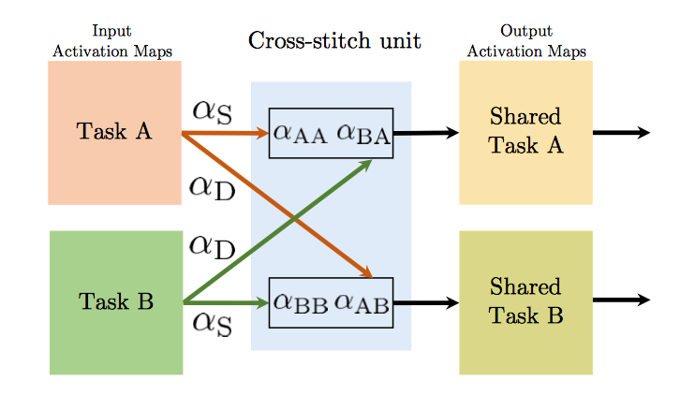
Cross-stitch unit (Misra et al., 2016)
Notes:
Evaluated on two pairs of tasks:
semantic segmentation and surface normal prediction on NYU-v2
object detection and attribute prediction on PASCAL VOC 2008.

Slide 17
Joint Many-Task Model (Hashimoto et al, 2017)
Hierarchical MTL for textual entailment classification
Supervised low-level auxiliary tasks:
POS tagging
Chunking
Dependency parsing
https://arxiv.org/pdf/1611.01587.pdf

Slide 18
Examples of auxiliary tasks
In computer vision:
predicting different characteristics of the road as auxiliary tasks for predicting the steering direction in a self-driving car (Caruana, 1998)
use head pose estimation and facial attribute inference as auxiliary tasks for facial landmark detection (Zhang et al., 2014)
In NLP:
jointly learn query classification and web search (Liu et al., 2015)
phoneme duration and frequency profile for text-to-speech (Arik et al, 2017)

Slide 19
Predicting features as an auxiliary task
Predicting whether an input sentence contains a positive or negative sentiment word as auxiliary tasks for sentiment analysis (Yu et al., 2016)
Predicting whether a name is present in a sentence as auxiliary task for name error detection (Cheng et al, 2015)

Slide 20
Adversarial auxiliary tasks
Using a task with the objective that is opposite to what we are trying to achieve
Examples:
Adversarial multi-task learning for text classification (Liu et al., 2017)
Style Transfer in Text: Exploration and Evaluation (Fu et al., 2018)

Slide 21
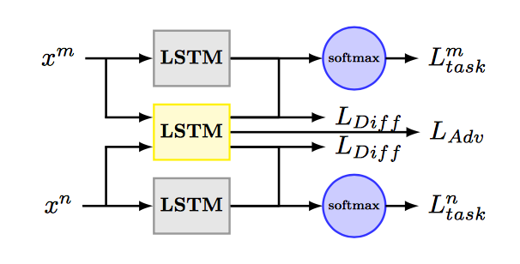
Adversarial multi-task learning for text classification (Liu et al., 2017)
Uses an adversarial objective to divide task-specific and shared spaces
Intuition: “a transferable feature is the one for which an algorithm cannot learn to identify the domain of origin of the input observation”

Slide 22
Style Transfer in Text: Exploration and Evaluation (Fu et al., 2018)
Multi-decoder model
Style embedding model
Adversarial
Adversarial

